Slide 1
Pre-Purchasing (OPP)
prepurchasing.ucdavis.edu
Going Live Monday, April 15, 2019

Slide 2
Home screen (dashboard)

Slide 3
OPP Roles
Requestor: person placing the order
Approver: PI or Department head responsible for ensuring the items ordered are allowable and allocable to the funds being charged.
Account Manager: Account Manager designated for a particular account(s) and/or PI.
Purchaser: COE Shared Service Staff
Reviewer: Person who can see orders placed (e.g., All requesters within a lab/group and all account/department managers)
Workgroup (within roles): Multiple people within a role to allow for back-up approvals if someone is out.

Slide 4
Tabs and Numbers
Orders pending your approval (PI, Account Manager)
Select to place an order
Select to see a list of your orders
--Requestors/Approvers may see all orders
placed for the workgroup
--AM/M’s will see all orders for their dept.
Orders you have placed

Slide 5
Place an order – You are the ‘Requester’

Slide 6
Select Workgroup
If you belong to more than one workgroup, you’ll be asked for which workgroup you want to place your order from. Workgroups may be a Research Group/Unit, Center, or Department/Administrative Unit. It’s meant to capture different groups of people based on who the authorized approver is as well as who the Account Manager for that group is.

Slide 7
Justification and Business Purpose
Justification is required.
The Business Purpose is optional. Each department may decide they want this field used and will let those in their department know how to use it.
Required
Optional

Slide 8
Vendor and Shipping Address
You can leave the vendor as unspecified (default); select a vendor from the drop down screen; add a new vendor; or search from a vendor in the campus database. As you add a new vendor, you’ll see them in the drop down list in the future.
Required
Please include your email address
Required
The Deliver To name and address are required. Include your email as well. You can select an address from the prepopulated drop down list or add a new shipping address. Most campus deliveries are made to COE Receiving at Bainer Hall and then are delivered to the main office of your department. Be sure you include your department name in the address field. However, if you need the items shipped off campus or to a different campus location than your home department, enter that address here.

Slide 9
Enter item information
Enter typical item information (quantity, Description, and unit cost are required fields).
If you click on the blue text bubble, you can add a URL and additional information about the item.
This box opens when clicking the comment box above.

Slide 10
Split accounting. Adding freight/shipping costs

Slide 11
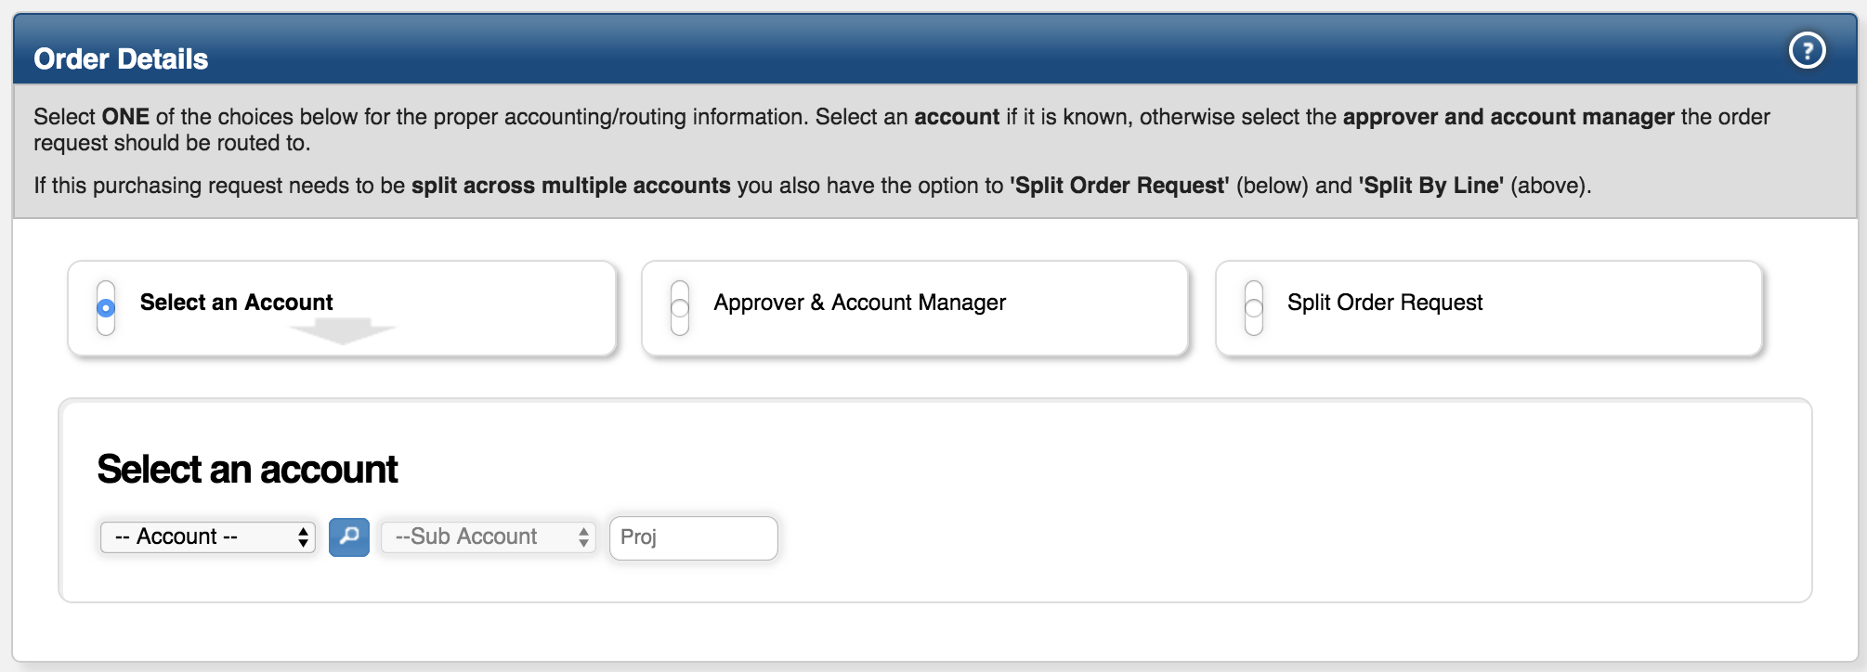
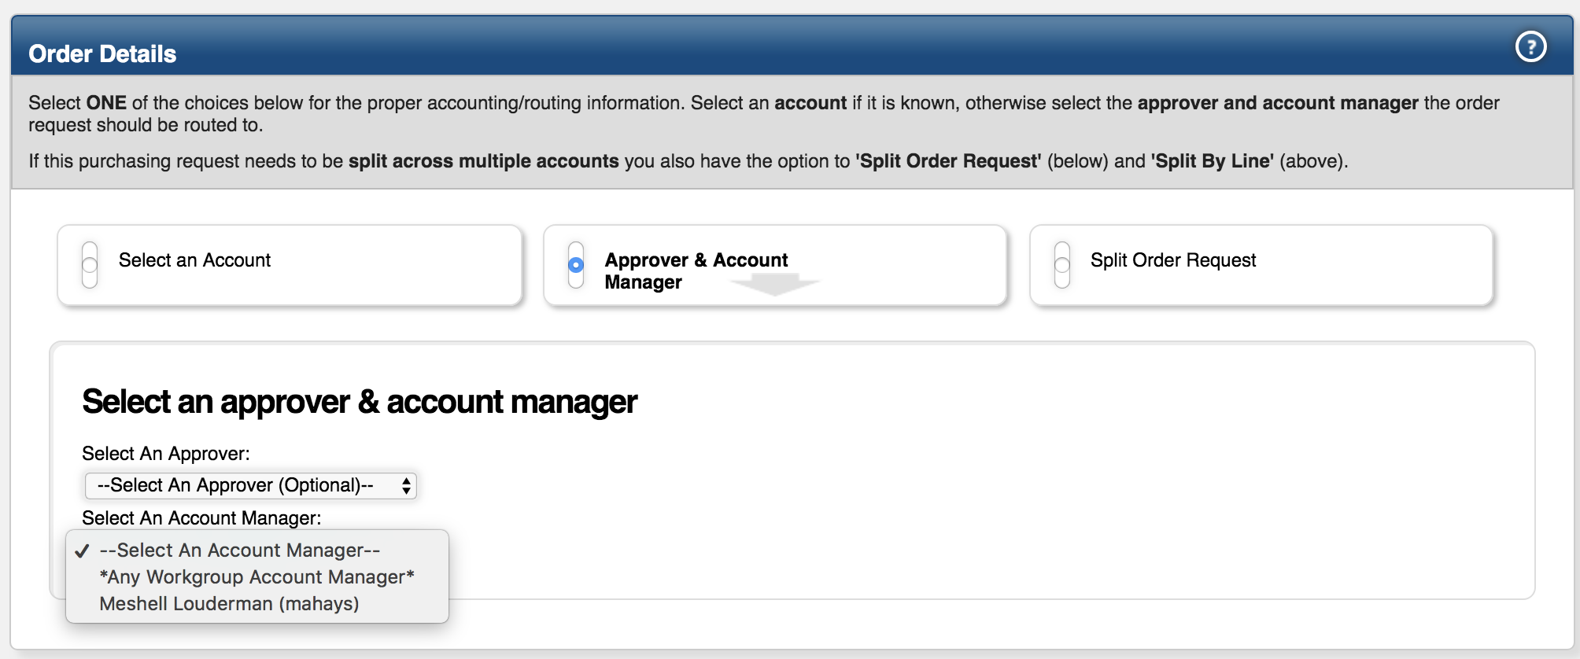
Order Details
Select the account (if known) from a drop down list that is pre-populated…
If you don’t know the account number, enter identifying information about the account (e.g., NSF Career or Coffee Project) in the ‘comment/special instructions’ box at the bottom of the order form.
… or Select “Approve & Account Manager”, then “Any Workgroup Account Manager” to route without designating an account.
There is also an option to split the entire order on multiple accounts. You can also split each line item when entering the line item information in the previous slide.
Click here 1st
Then here 2nd

Slide 12
Controlled Substance
Defaults to a Red No
Notice required fields

Slide 13
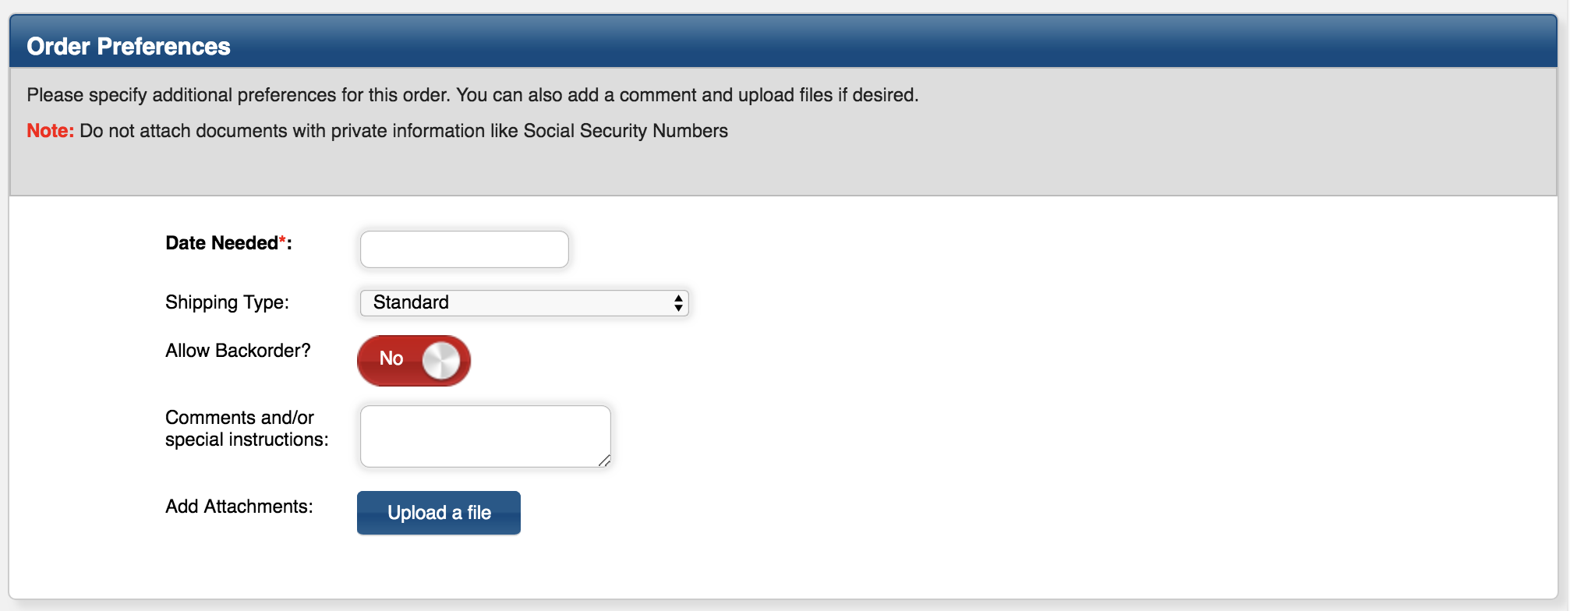
Order Preferences
Date Needed is required. Choose a realistic date (not the next day).
If you have an emergency order, email coe-purch@ucdavis.edu with the order number and justification for why it’s an emergency. By campus policy, an emergency is defined as Life Threatening, Catastrophic Events, Critical Equipment Failure, Organized Labor Strikes, Weather Conditions, or Public Safety. Sales and travel deadlines are not considered emergency situations.
Shipping options include:
Standard (default)
Expedited
No Shipping Required
Overnight
Vendor Will Deliver
Will Call
Comment box can be made bigger if needed. Use the comment box to identify the order as a fabrication. You must include the Asset/Fabrication number, Custodial Code, Building, and Room number.
Can attach a quote, invoice, etc.

Slide 14
Final Step
At the bottom of the form you can click the blue “Create” button to route the order for approvals and then to purchasing for ordering.
You can click on the blue “Save for Later” button if you need to come back to the order without submitting it.
Click here to open saved orders, not submitted
Click here to see past orders already placed.
Click here to see your ‘open’ orders.

Slide 15
View Order History Tab
See the status of an order, review order information, see if the order has been received, etc.
You can personalize this screen by clicking on the blue ‘Update Column Preferences’ button.
You can use the filters or search box to look for certain orders based on certain criteria.

Slide 16
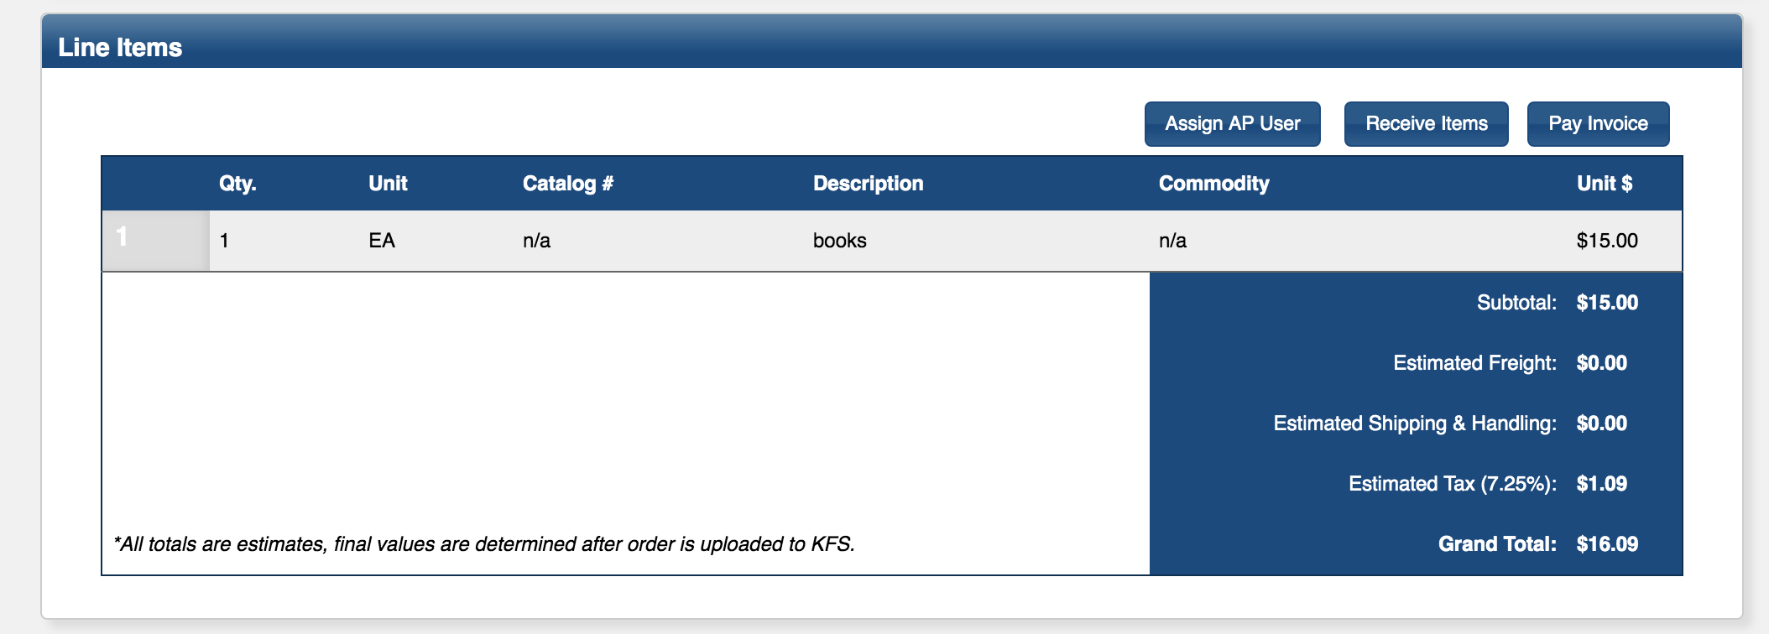
Receiving
Don’t forget to come back to the OPP system to mark your order as received once you receive the item(s) you requested.
Click on your order from the ‘View Order History’ tab. Click on the blue “Receive Items” button in the middle of the order under Line Items.

Slide 17
Line Item Receiving
Select the blue “Receive All” button if you have received all items.
If you have received part of the order, enter the number of units you have received, then click the blue “Record Items” button

Slide 18
Approver Role (PI or Department Head)
Click on the link provided in the email you receive stating you have an order pending your approval or login at prepurchasing.ucdavis.edu
Click on the ”Pending your action” tab. Orders pending your approval will show up below. Click on the order # to open.

Slide 19
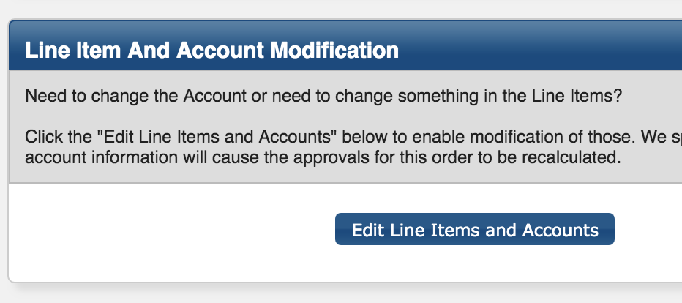
Review, edit, add notes, upload a file…
If requestor did not select an account or did not include a note about which account to charge either edit the order to add the account or add a note with the account info. Click on the blue edit button, inside the order click on the blue “Edit Line Items and Accounts”. You can then edit the line items and/or add an account.

Slide 20
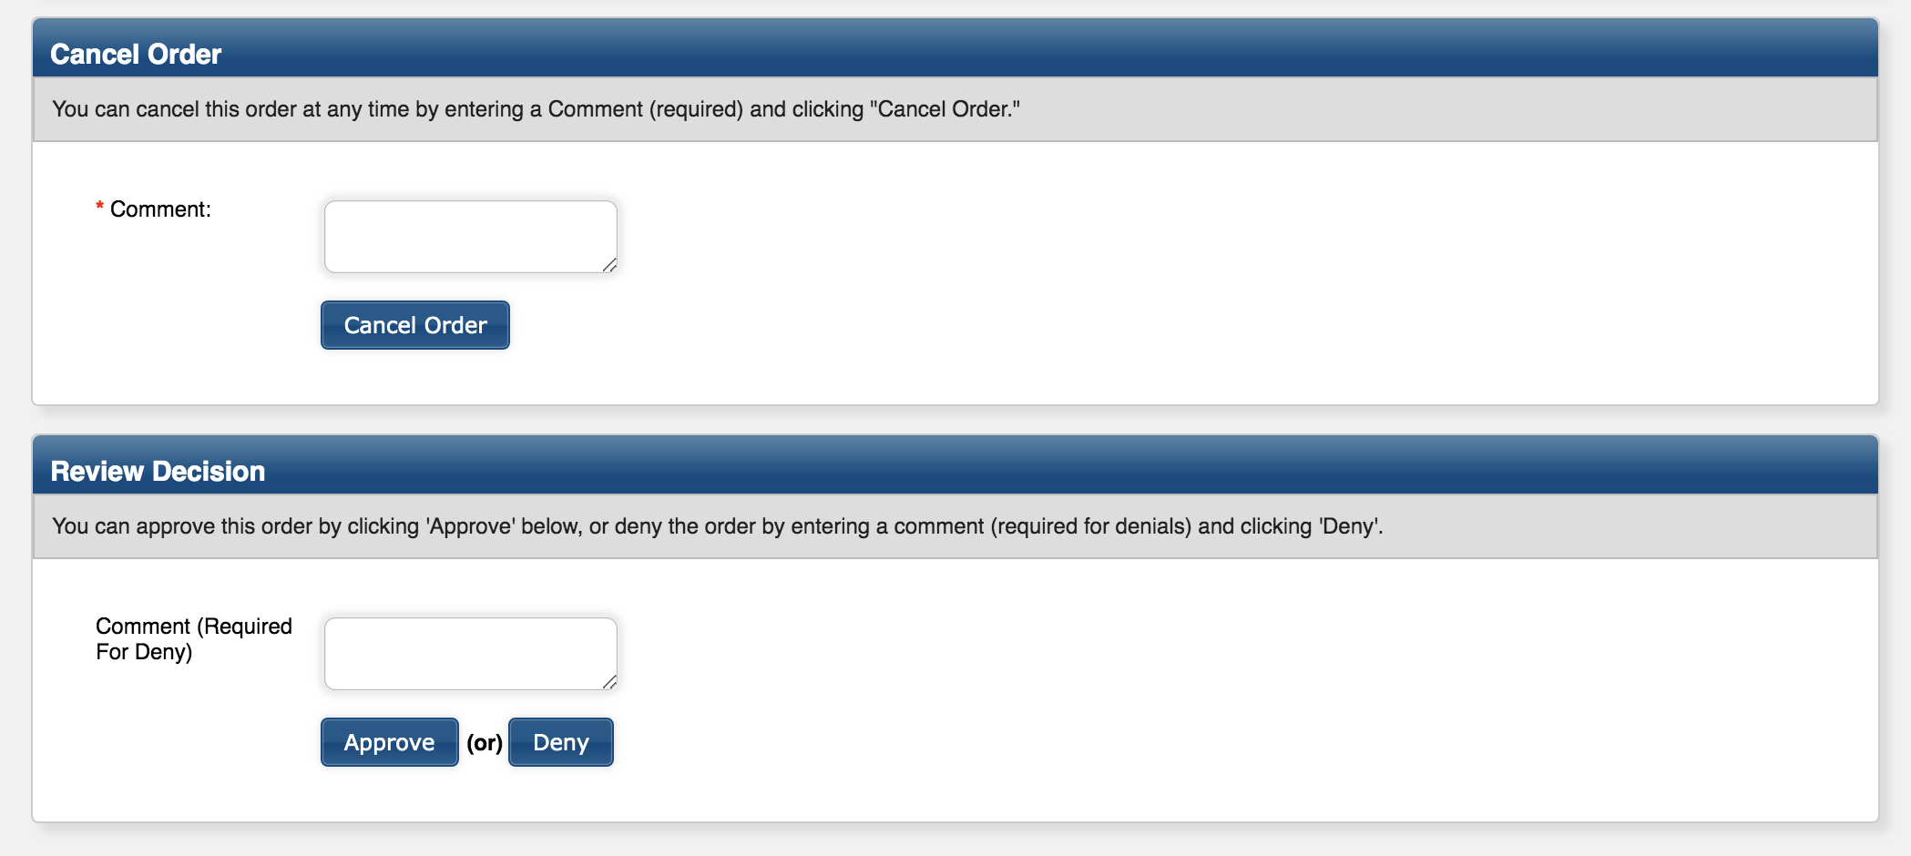
Cancel, Deny, or Approve the order
An approver can cancel, deny, or approve the order. Comments are required if you select cancel or deny.

Slide 21
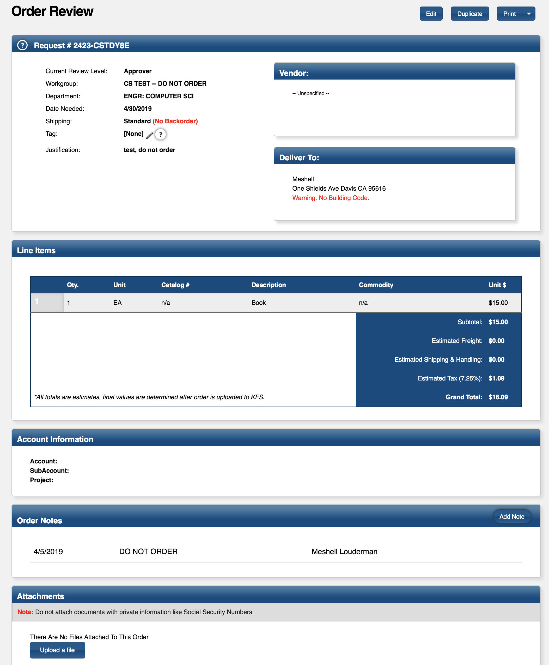
Routing to Account Manager for Approval
The Account Manager can edit the order, add notes, upload attachments, reroute approval to a particular account manager in the workgroup, and deny or approve the order.
If requestor/approver did not select an account you will need to edit the order to add the account.
Processing note: If there is an account listed in the account field _and_ an account listed in the notes section, the account in the notes sections will override whatever is in the account field. You can search by account in the order history screen.
If anyone along the process clicks on the blue magnifier glass in the ‘Select an account’ area, all workgroup routings will be overridden. The order will only route to the KFS Account Manager. Delegates or other workgroup members will not be able to see the order.

Slide 22
Routed to COE Shared Service for processing …
You can click here to duplicate the order.
Tells you where the order is in the process (e.g. Approver, Account Manager, Purchaser, or Complete)
Tag = credit card confirmation number or KFS/AggieBuy doc number
Reference # = PCDO number

Slide 23
Order Notes and Attachments
Shared Service Purchasing will use the order notes section to provide ordering info and updates along the process. Check in OPP for status updates, back-order info, ETA, etc. They may also upload pertinent information to the order (e.g., AggieBuy screen to confirm what was ordered).

Slide 24
Order History

Slide 25
Email notifications
Click on the blue order request number or log on to prepurchasing.ucdavis.edu to access the order request.
Pending PI/Dept approval
Pending Account Manager approval

Slide 26
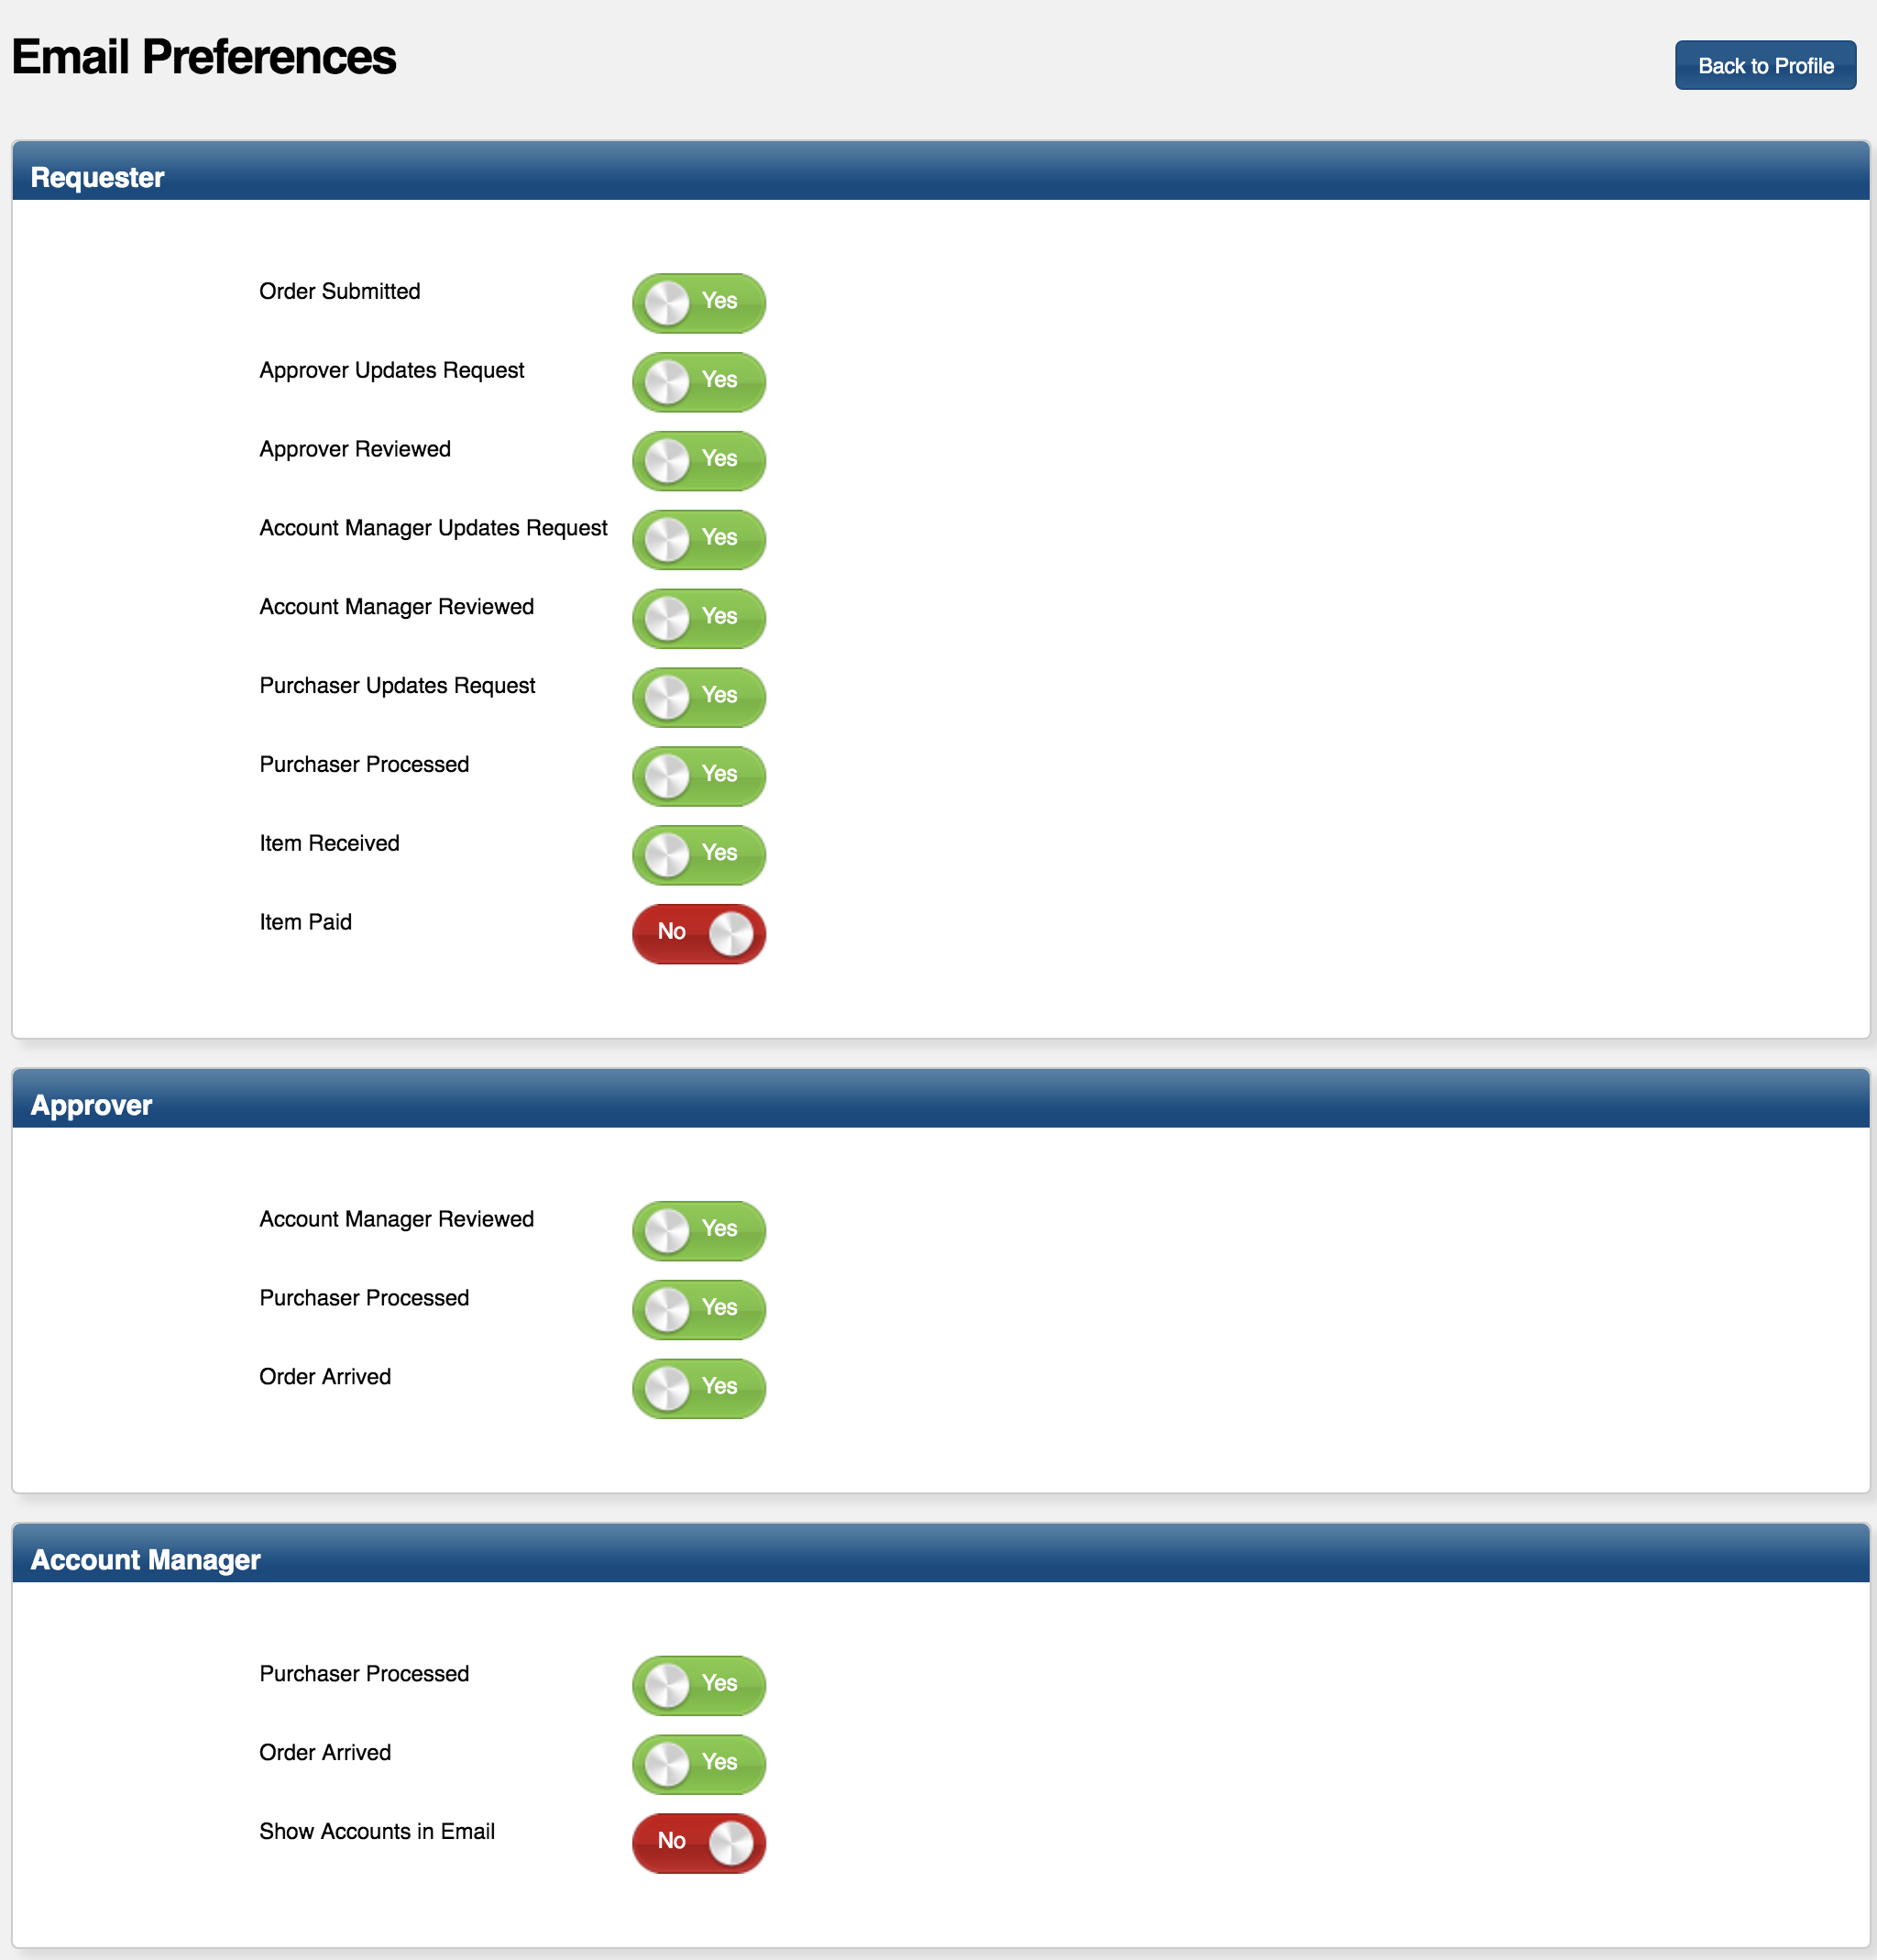
Email Preferences based on role
To set your email preferences, click on the ‘Profile’ tab in the upper right corner of the PrePurchasing home screen/dashboard.
You will see options based on your designated role(s)
Click the radial button to switch between Yes and No.

Slide 27
General Email Preferences
PerEvent
Daily
Weekly
Make sure you save your preferences

Slide 28
Information and Resources
Website for COE Shared Service (SS): Purchasing (under renovation)
Intranet.engineering.ucdavis.edu/shared-services/purchasing-and-accounts-payable
OPP Website: prepurchasing.ucdavis.edu
COE SS email for questions and help: coe-purch@ucdavis.edu
OPS will be shut off May 1st, 2019

