Slide 1
Joseph M Smith 1916 - 2009

Slide 2
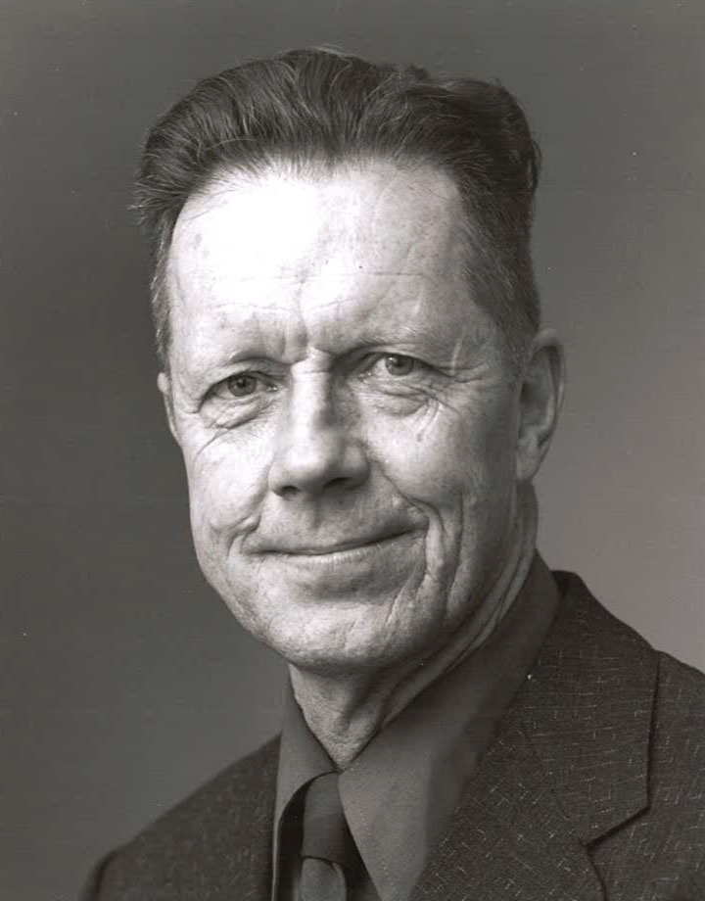
Joe Mauk Smith

Slide 3
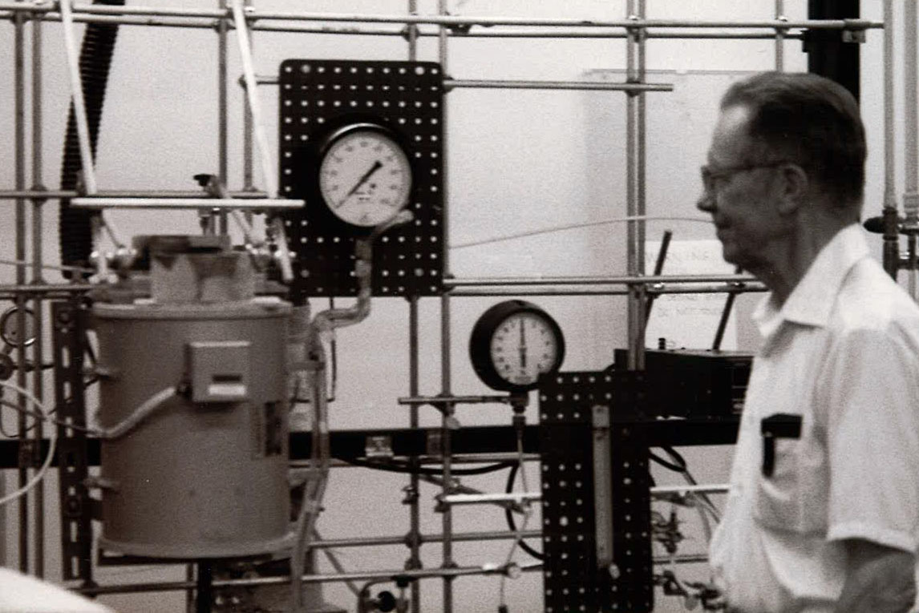
“Mr. Chemical Engineering”

Slide 4
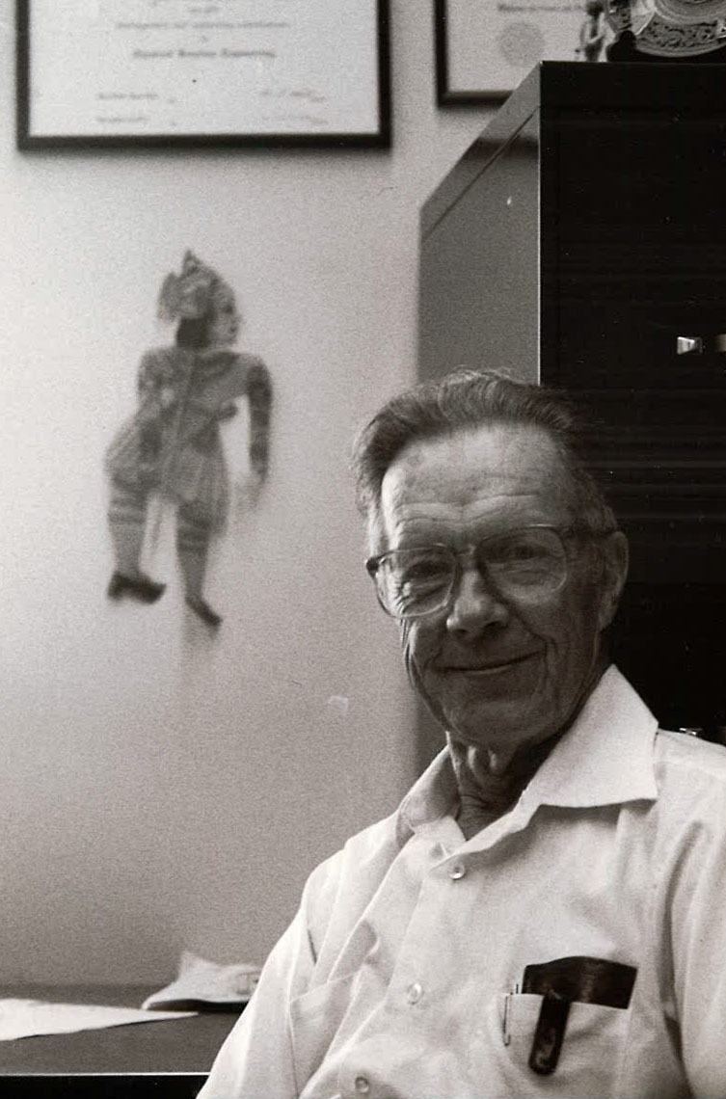
Founding Chair Chemical Engineering Department

Slide 5
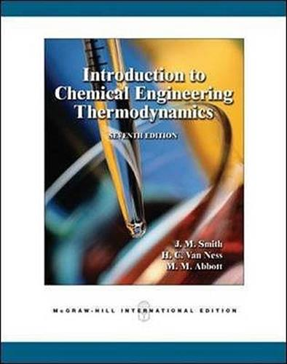
Introduction to Chemical Engineering Thermodynamics J.M. Smith
Introduction to Chemical Engineering Thermodynamics was first published in 1947 in paperback for his students at Purdue. In 1949, McGraw-Hill published the first regular edition. A decade later, Purdue colleague Hank VanNess collaborated with Joe in writing the second edition which appeared in 1959. In 1996 Michael Abbott joined Joe and Hank in writing the fifth edition. The book, now in its seventh edition is still one of the most widely adopted chemical engineering thermodynamics textbooks and has now been used by generations of chemical engineers.

Slide 6
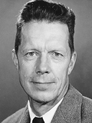
Professor Emeritus
Joe Smith was the founding chair. Joe insisted on the formation of the Chemical Engineering Department 50 Years ago, the first department formed in the new College of Engineering.

Slide 7
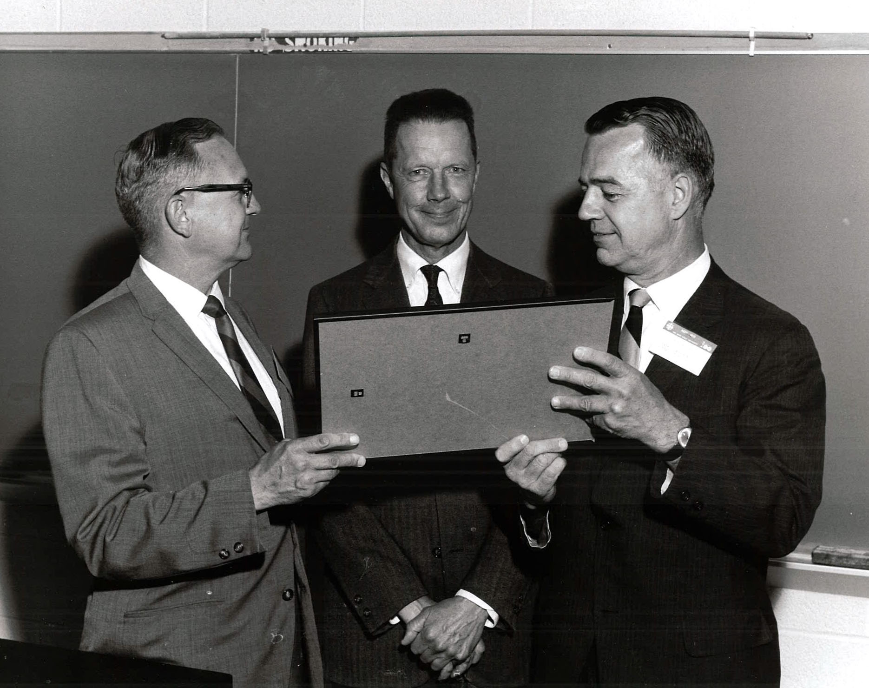
Ohio State University Awards Ceremony

Slide 8
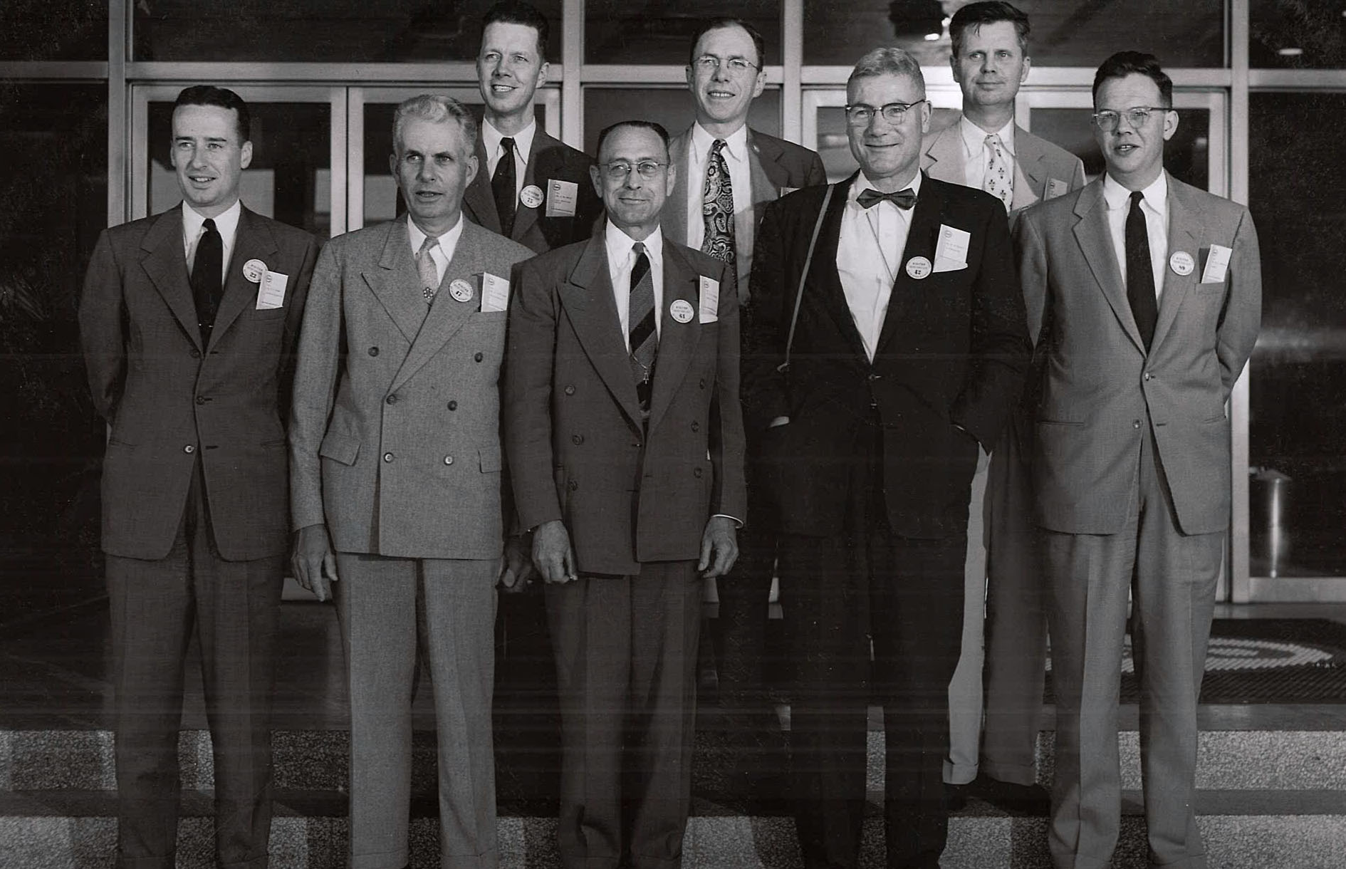
Baton Rouge Refinery – Esso Standard Oil Company April 18, 1955

Slide 9
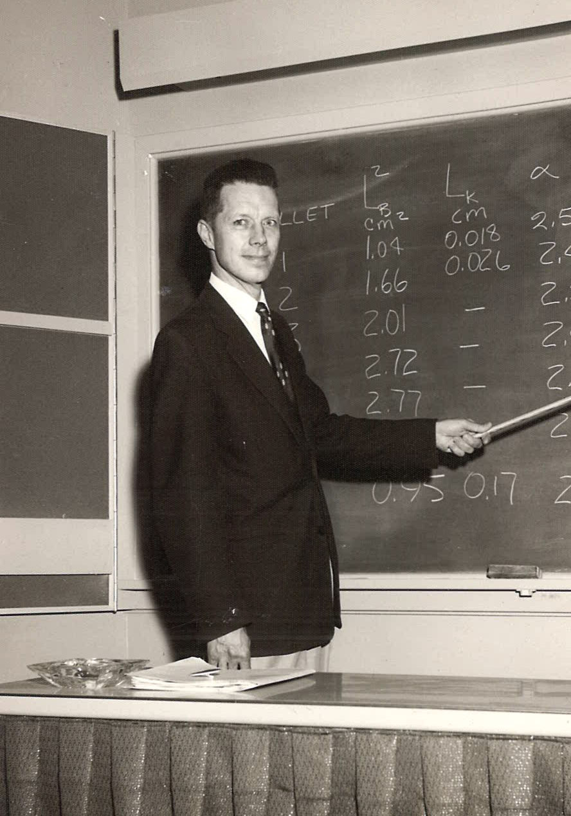
Universal Oil Products Des Plaines, Illinois July 1961

Slide 10
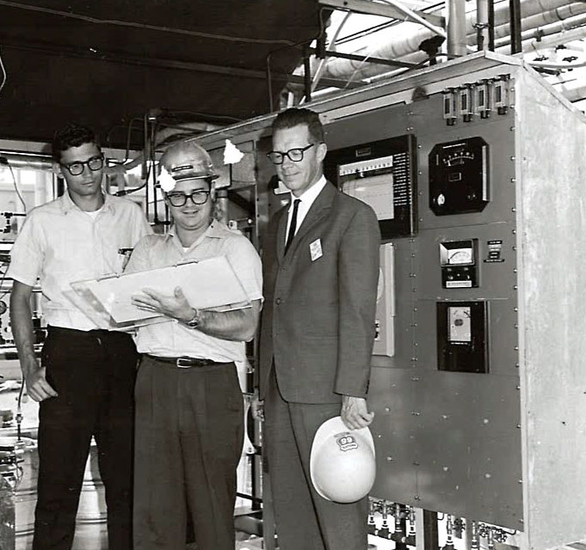
Bartlesville Petroleum Plant June 1965

Slide 11
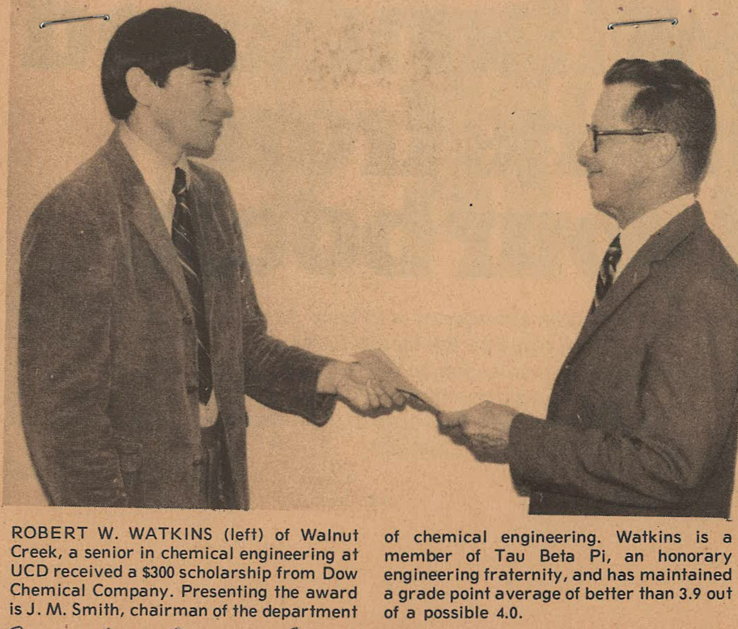
Presenting a Scholarship Award August 24, 1971

Slide 12
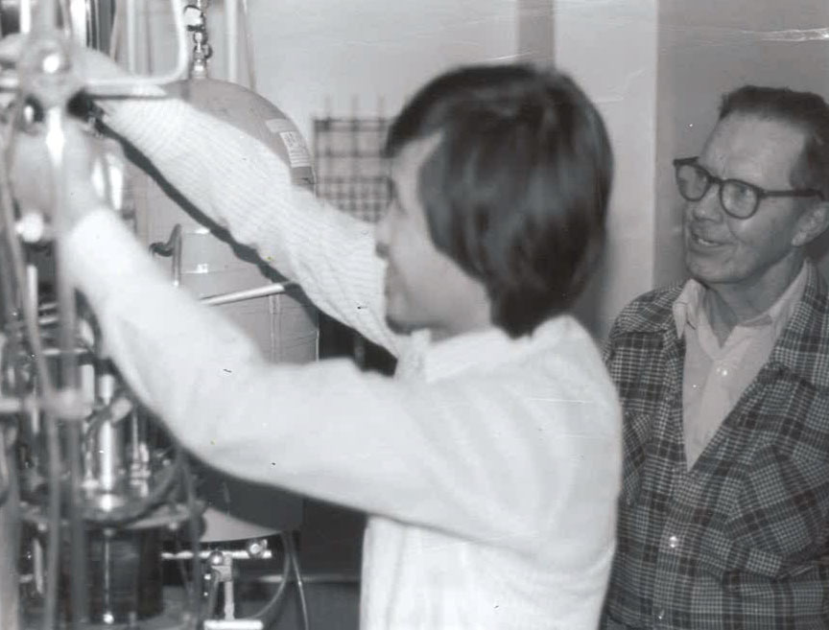
A scholar of international stature, yet a warm, and sensitive person who thoroughly enjoyed the company of others A very charismatic leader who knew how to motivate people

Slide 13
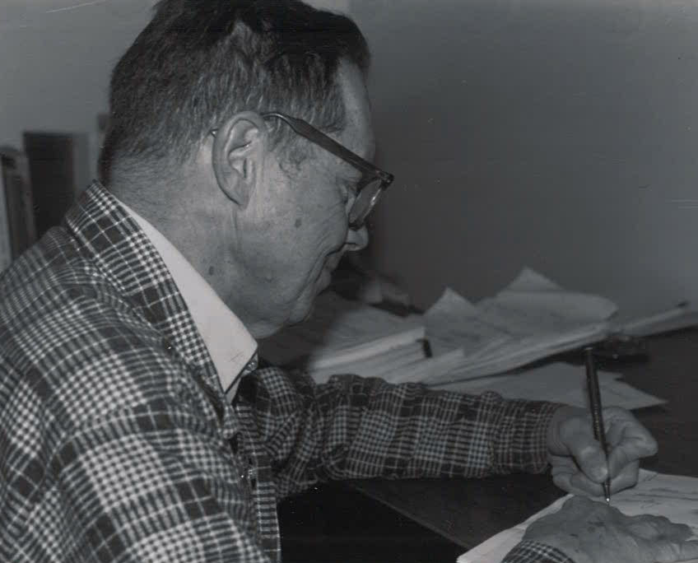
Joe’s work gained recognition through his major textbook, his journal publications, and the prominence of his former students

Slide 14
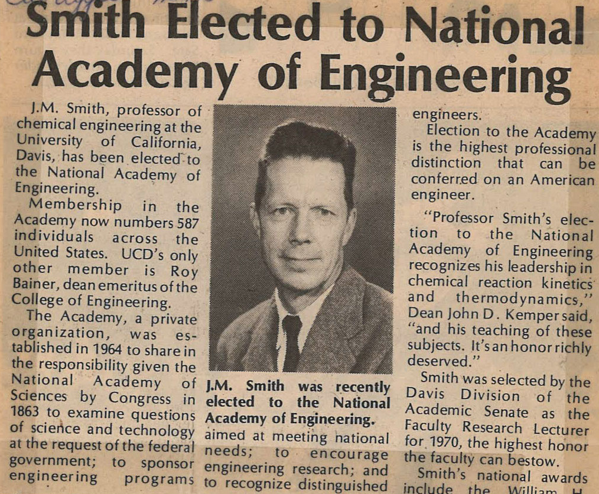
Elected to the National academy of Engineering 1975

Slide 15
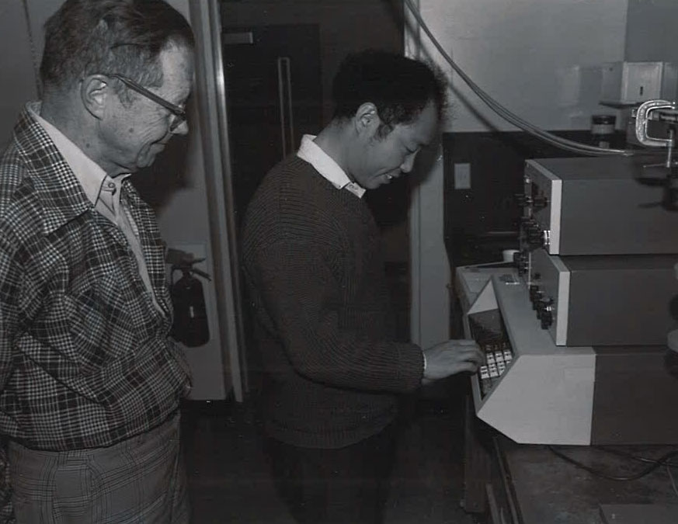
Joe always motivated his students by giving Praise for Work Well Done

Slide 16
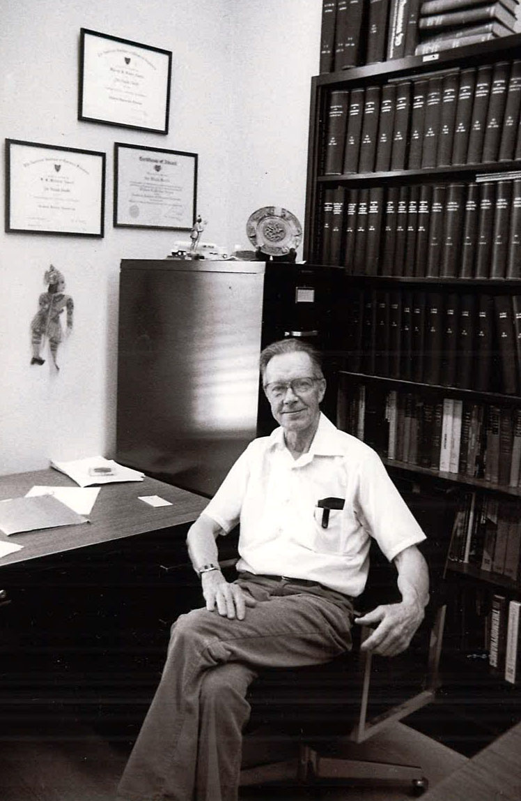
Joe was arguably the most influential educator in the history of chemical engineering

Slide 17
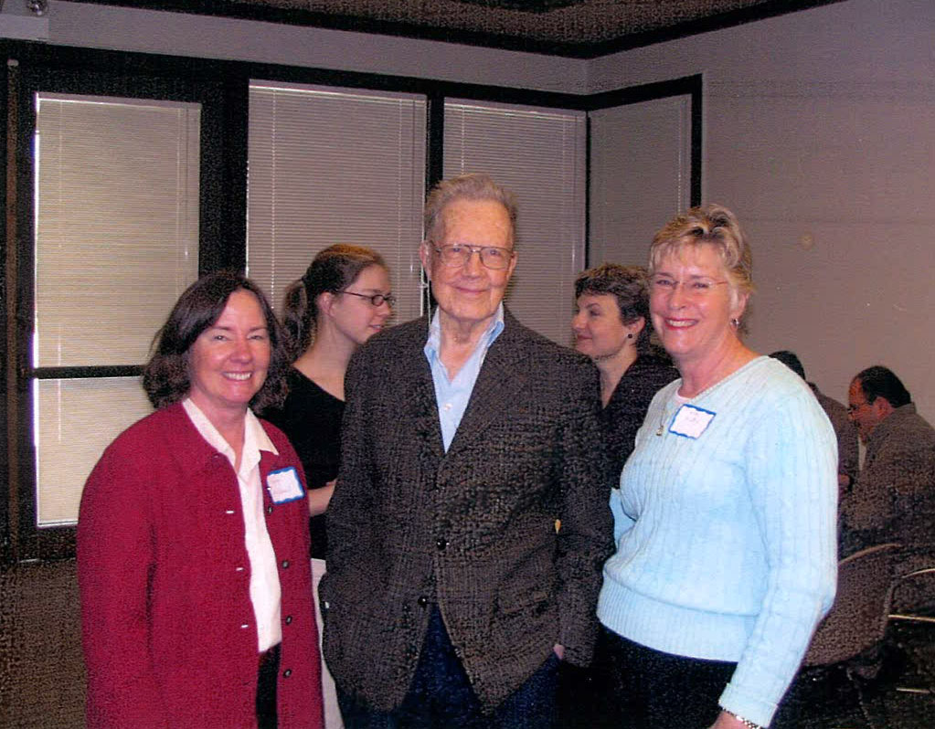
Joe Smith retired in1986, but remained a highly visible presence in the department

Slide 18
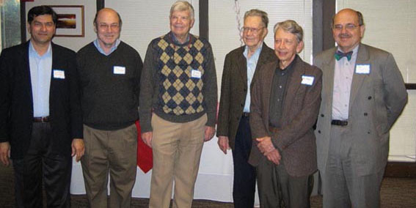
Joe’s 90th Birthday Party UCD – February 2006

Slide 19
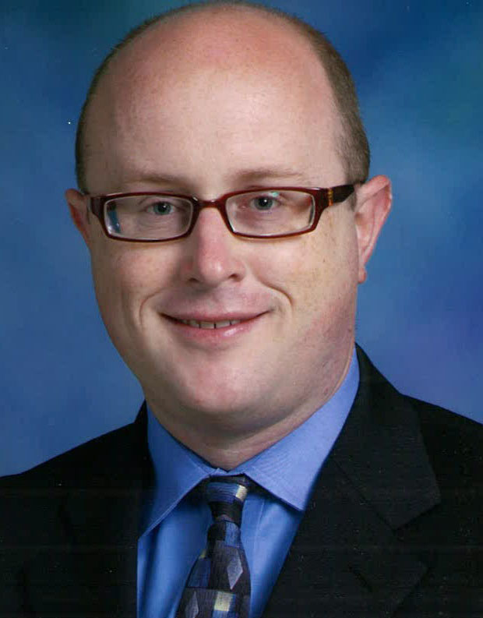
Joe and Essie Smith Endowed Chair
Joe and his wife Essie endowed the “Joe and Essie Smith Chair” in Chemical Engineering in 1996. The chair is dedicated to the support of outstanding young faculty members.
Bill Ristenpart
The Current holder of the Endowed Chair

Slide 20
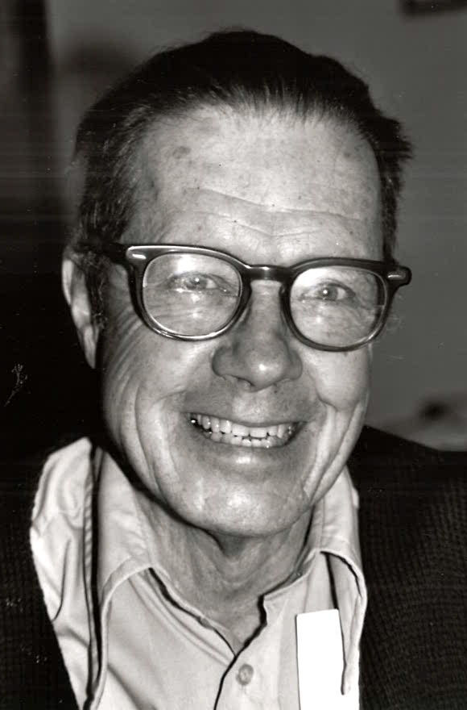
Joe Smith Distinguished Lecture
The Joe Smith Distinguished Lecture was established in the Department of Chemical Engineering and Materials Science at the University of California, Davis, to honor the late Professor J. M. Smith, the founding Chair of the Department and member of the National Academy of Engineering.
Previous Distinguished Lecturers
Matthew Tirrell (1997)
William B. Russel (1998)
Mark E. Davis (1999)
Buddy Ratner (2000)
Robert H. Davis (2002)
Gregory Stephanopoulos (2003)
Frank S. Bates (2004)
Douglas A. Lauffenburger (2005)
Alice P. Gast (2006)
Pablo G. Debenedetti (2007)
David A. Tirrell (2008)
Howard A. Stone (2009)
Carol K. Hall (2010)
Paul Alivisatos (2011)
Peter Stang (2012)
Babatunde A. Ogunnaike (2013)
Paula T. Hammond (2014)

