Slide 1
GRAD STUDENTS

Slide 2
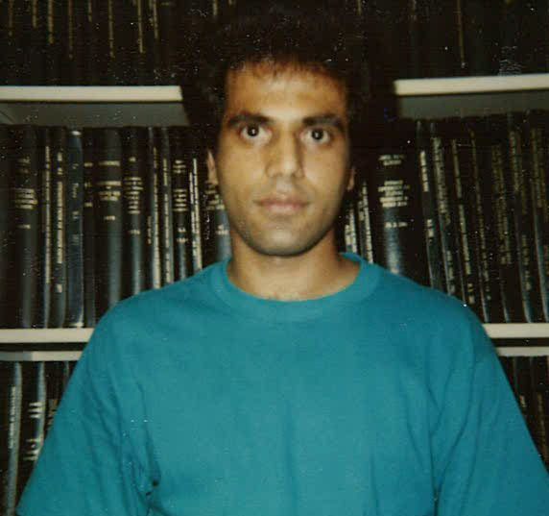
Iftikhar Gohar

Slide 3
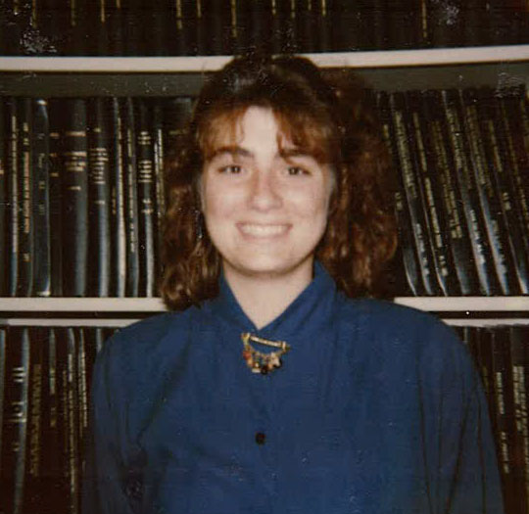
Annette Clasen Hagewiesche

Slide 4
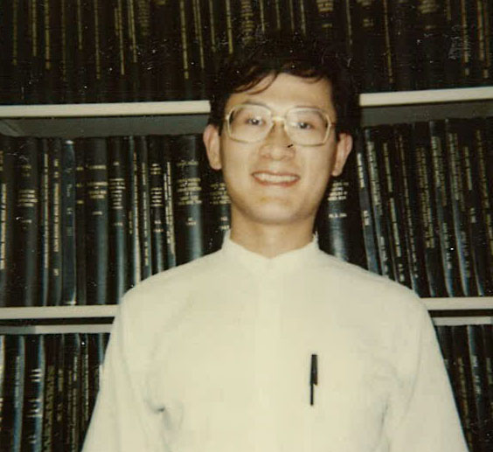
Wei-Wang Chen

Slide 5
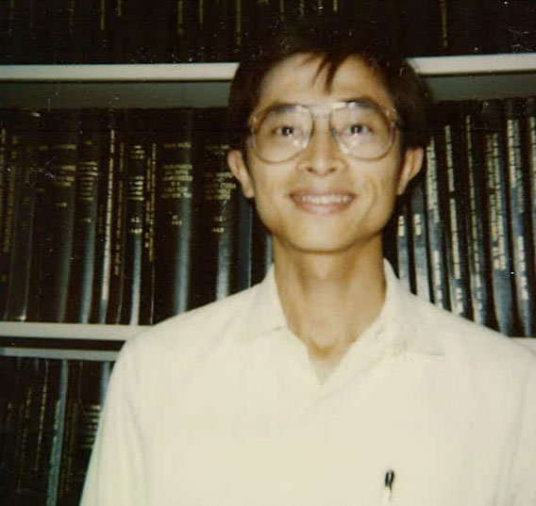
Yen Ko

Slide 6
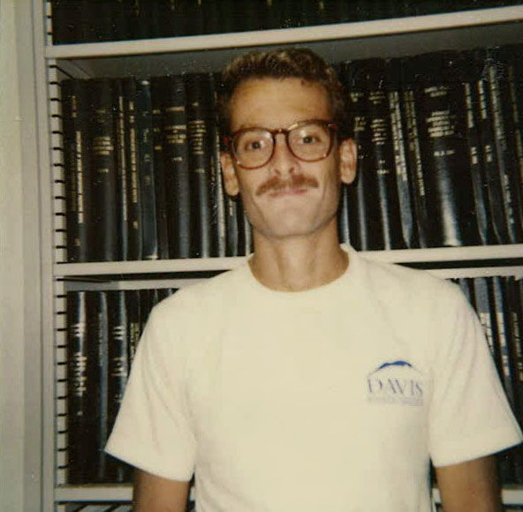
Alberto Goenaga

Slide 7
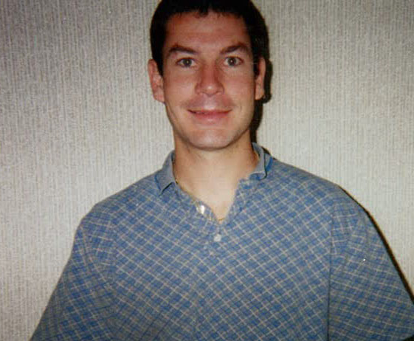
Brent Fresz

Slide 8
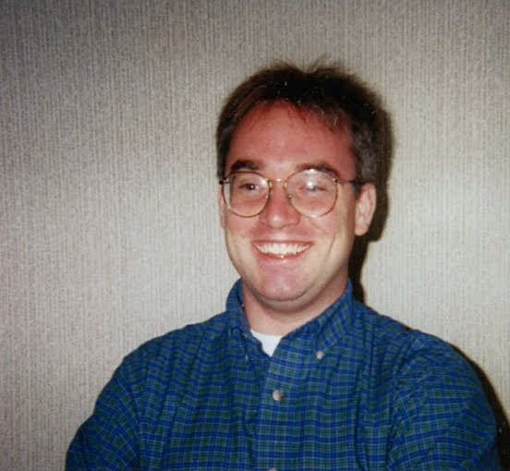
Jesse Goellner

Slide 9
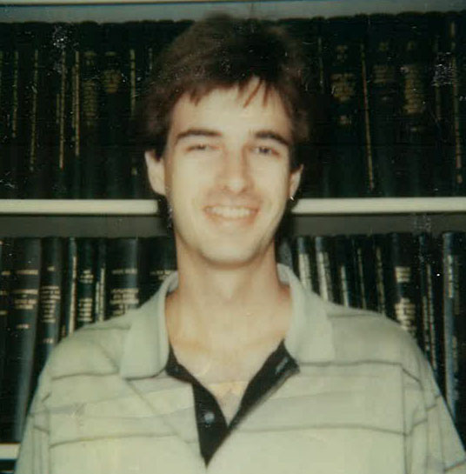
Michael Turney

Slide 10
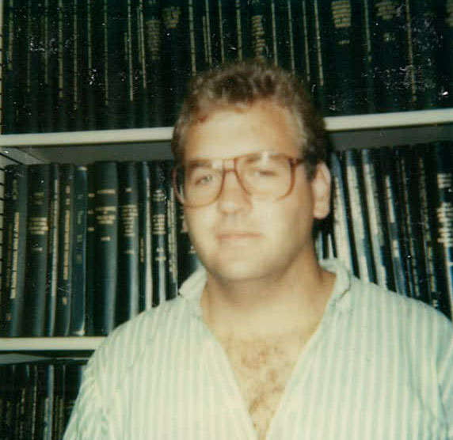
Paul Bruinsma

Slide 11
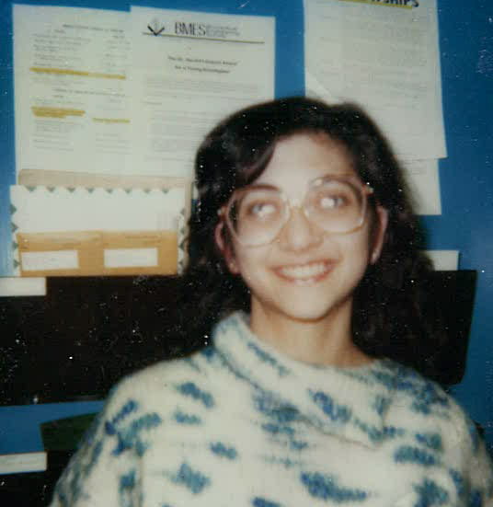
Ayse Batigun

Slide 12
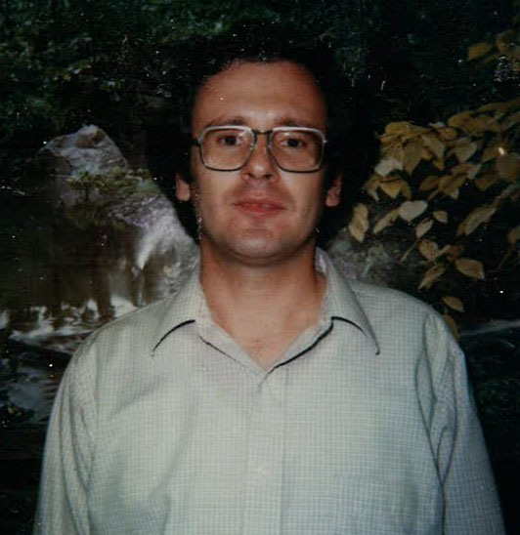
Mustafa Ozilgen

Slide 13
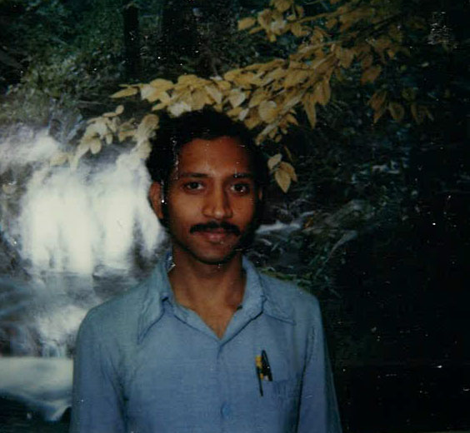
Rao Krovvidi

Slide 14
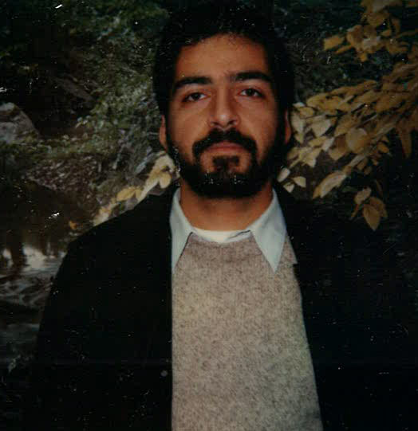
Iraj Rahmim

Slide 15
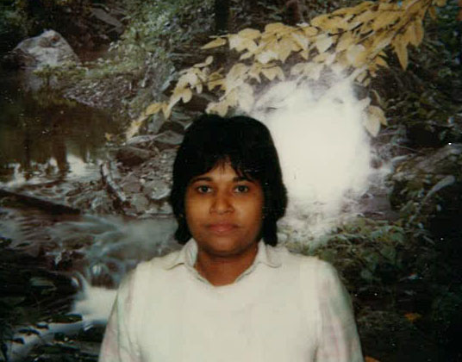
Leela Rakesh

Slide 16
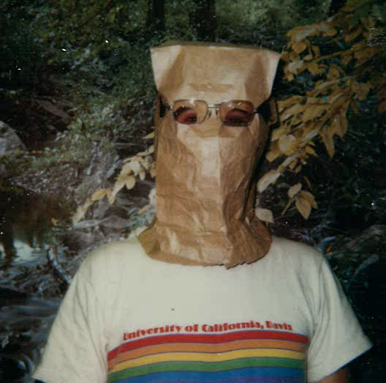
Kevin Donoghue

Slide 17
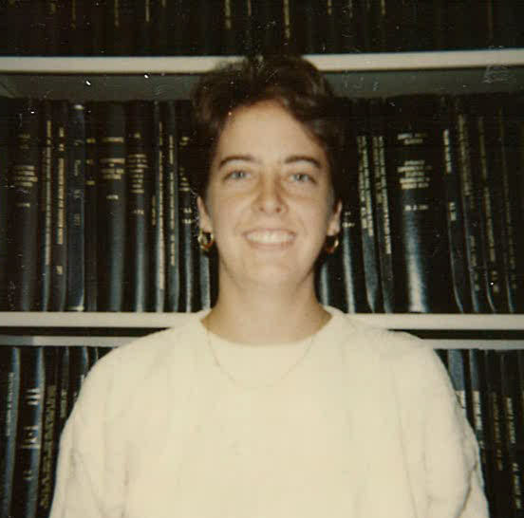
Joyce Lenz

Slide 18
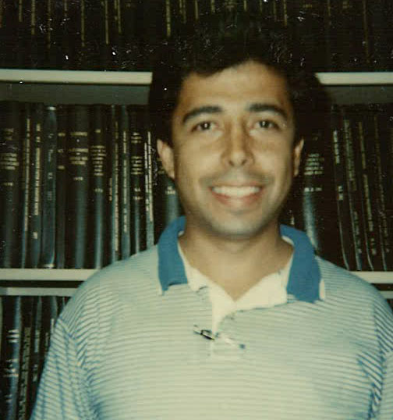
Marco Arocha

Slide 19
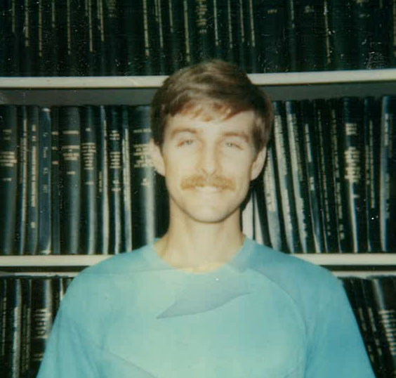
Steve Wisniewski

Slide 20
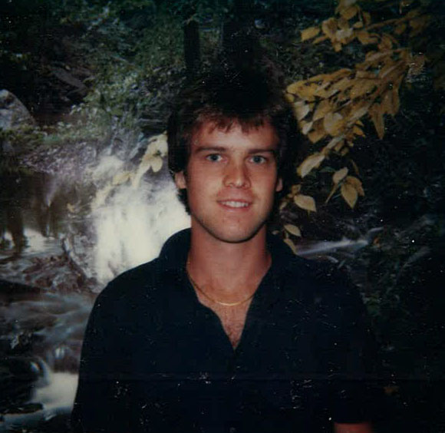
David Cippolla

Slide 21
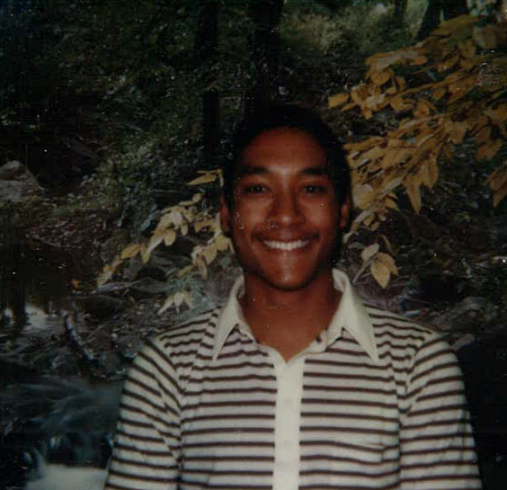
Brian Kim

Slide 22
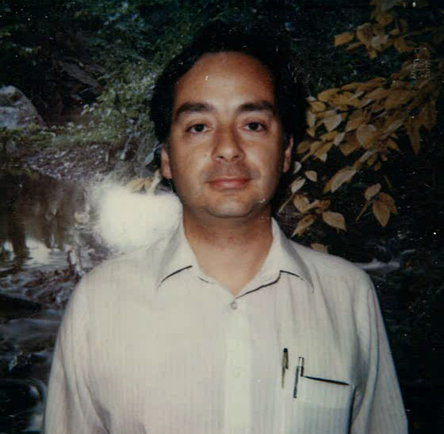
Jaime Triday

Slide 23
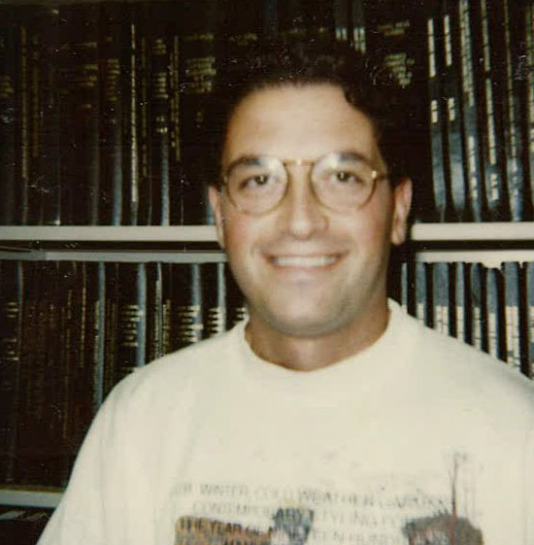
Ceki Celardin

Slide 24
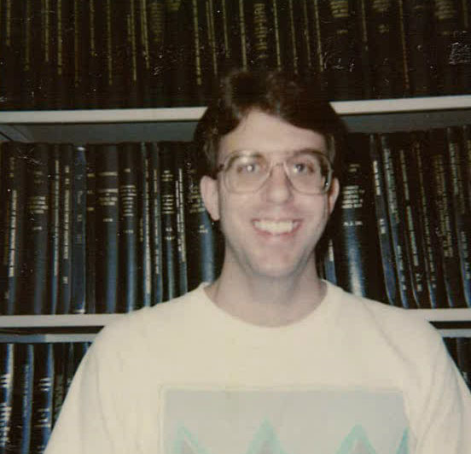
Scott Hazelwood

Slide 25
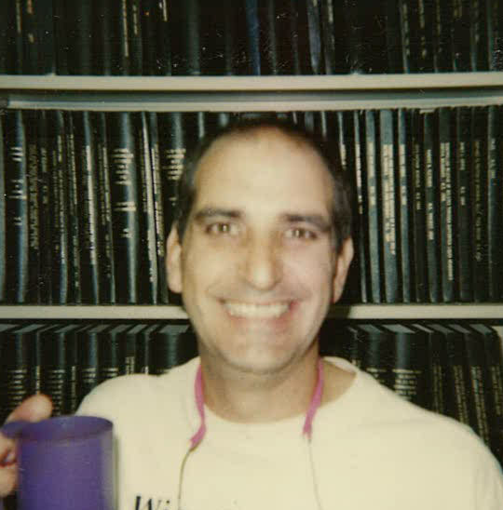
Alan Gering

Slide 26
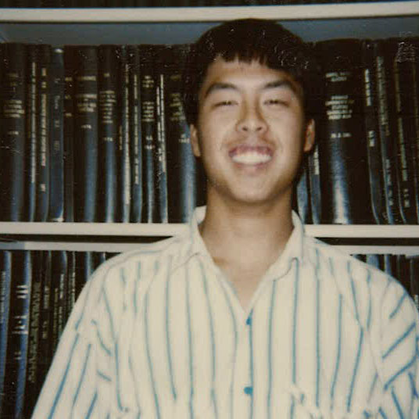
Bryant Sih

Slide 27
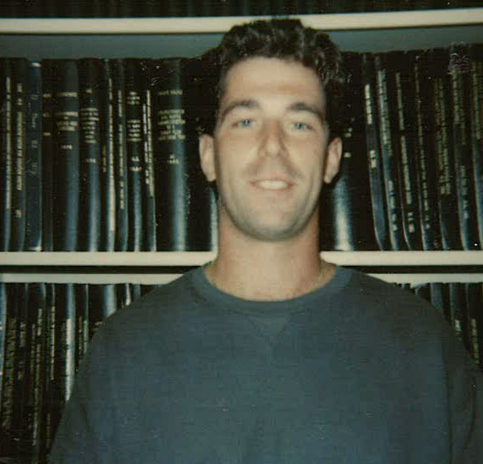
David Cote

Slide 28
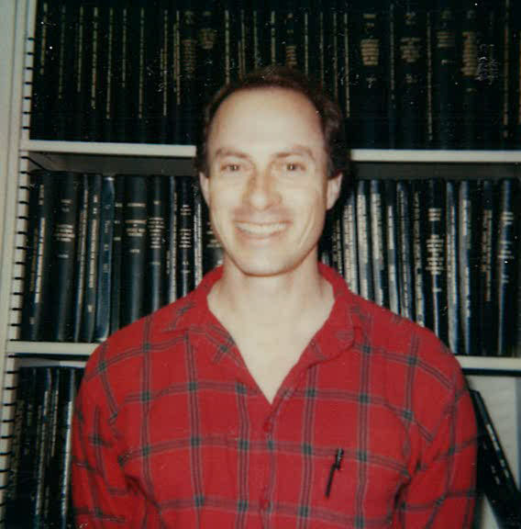

Slide 29
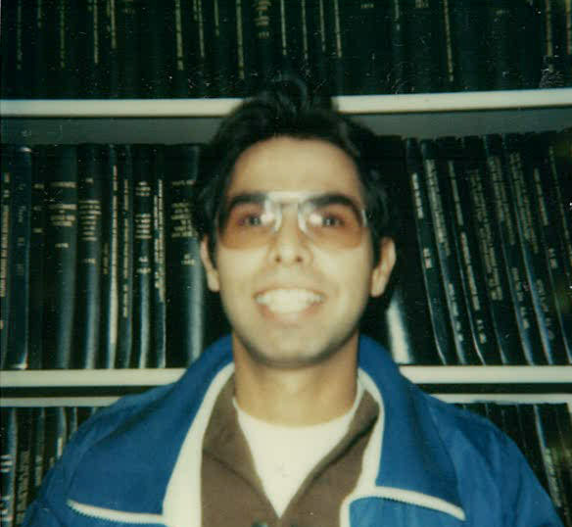
Daniel Styer

Slide 30
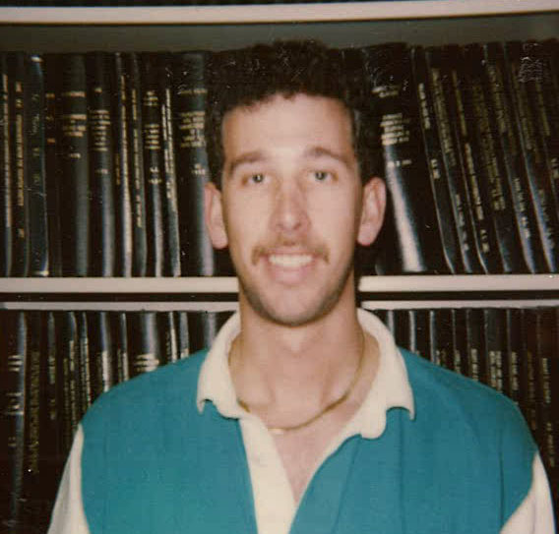
Joel Bach

Slide 31
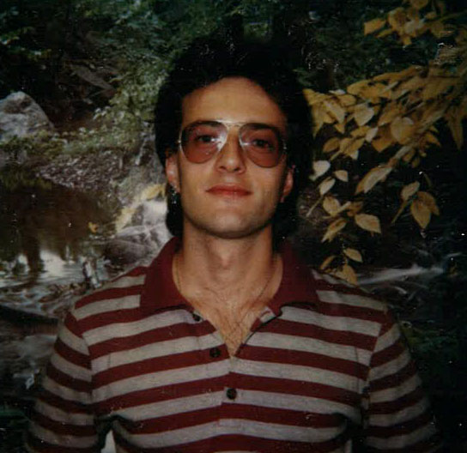
Stergios Pilitsis

Slide 32
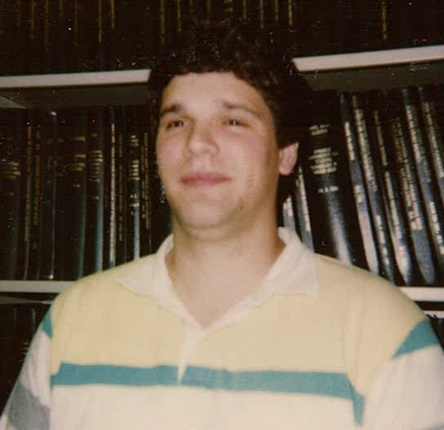
Joe Fell

Slide 33
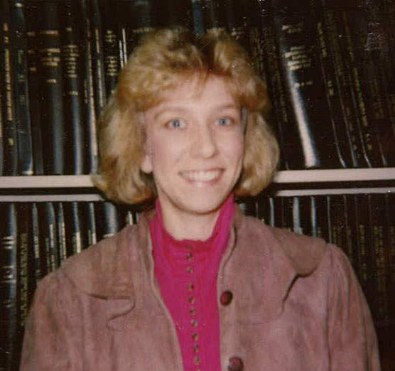
Gloria Lindner

Slide 34
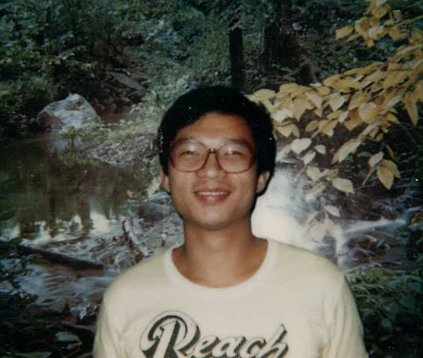
Xiaoqing Li

Slide 35
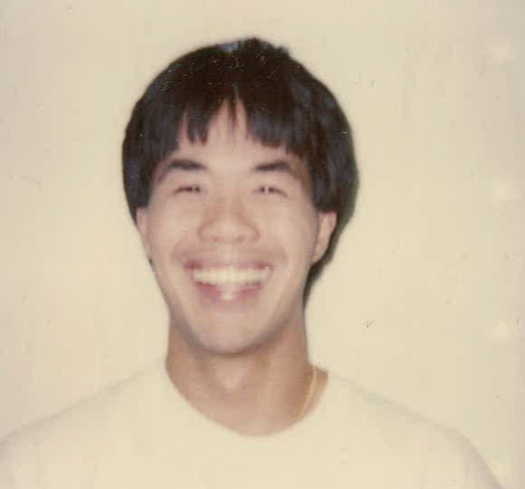
Greg Young

Slide 36
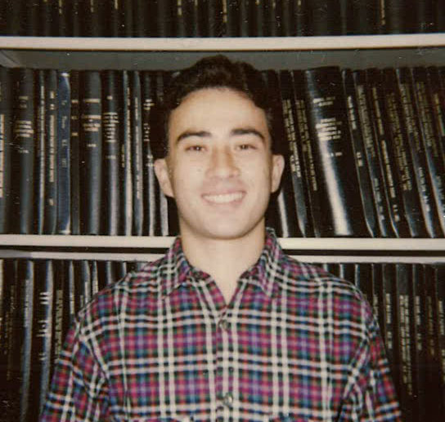
Slim Zegal

Slide 37
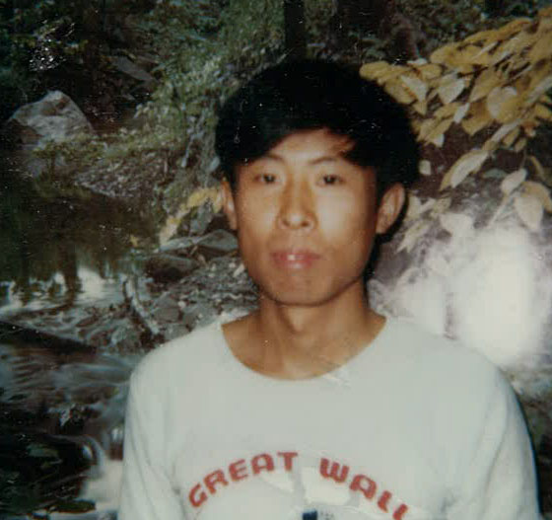
Guanghong Zheng

Slide 38
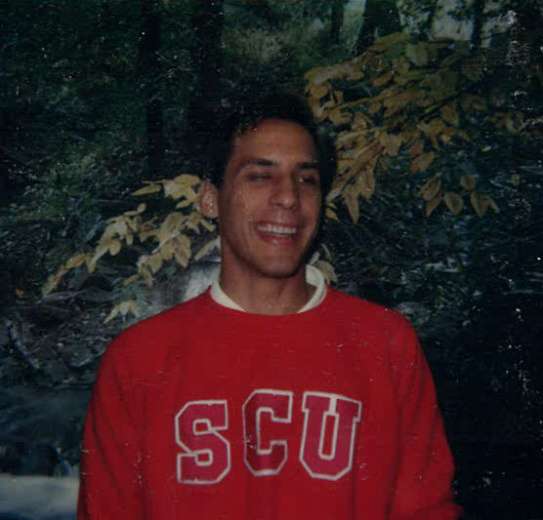
Tim Rehg

Slide 39
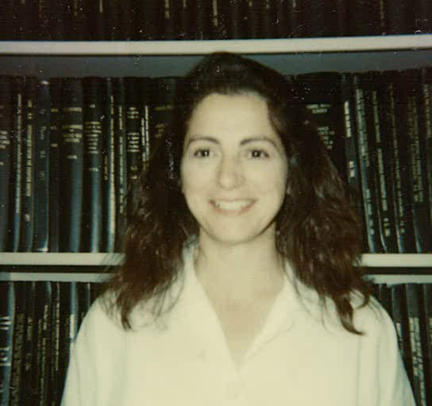
Mary Serra

Slide 40
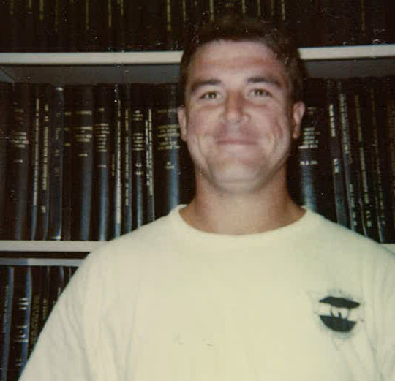
Joseph Seymour

Slide 41
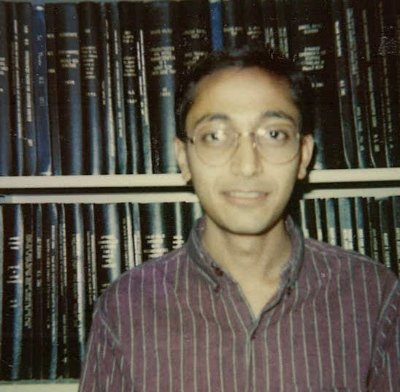
Kirti Patel

Slide 42
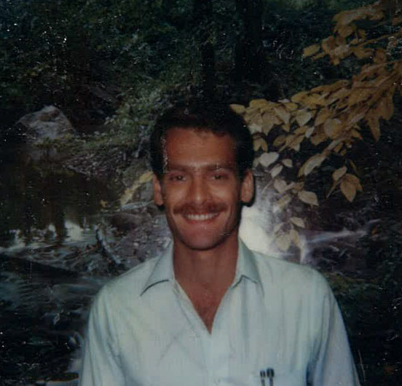
Alberto Goenaga

Slide 43
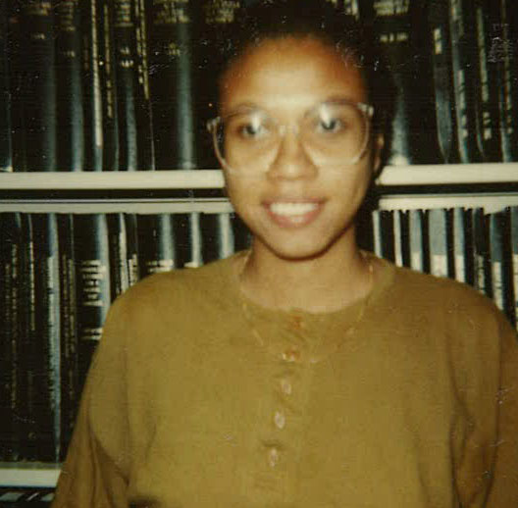
Shivaun Farinha

Slide 44
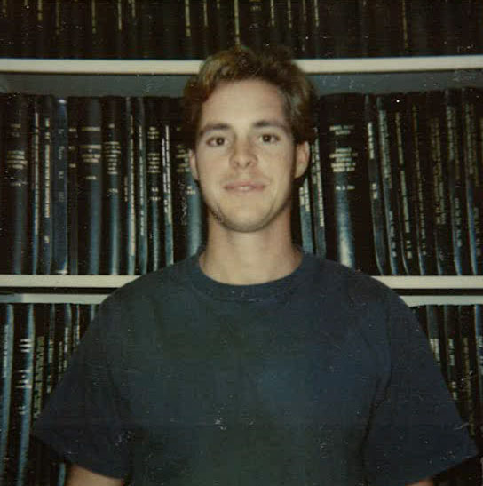
Erik Dunmire

Slide 45
Michael Cooney

Slide 46
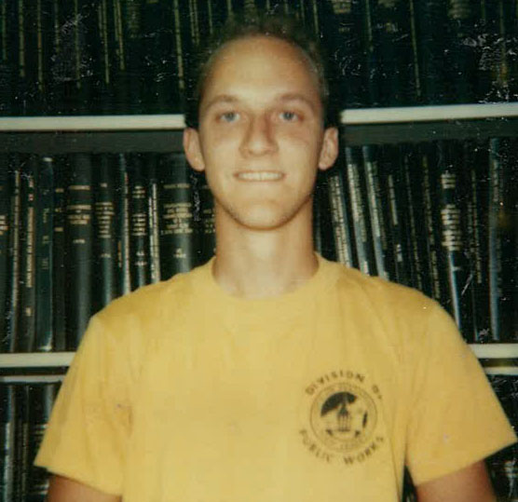
Eric Hanczyc

Slide 47
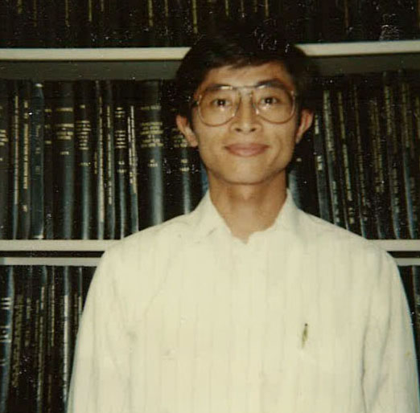
Yen-Huei Ko

Slide 48
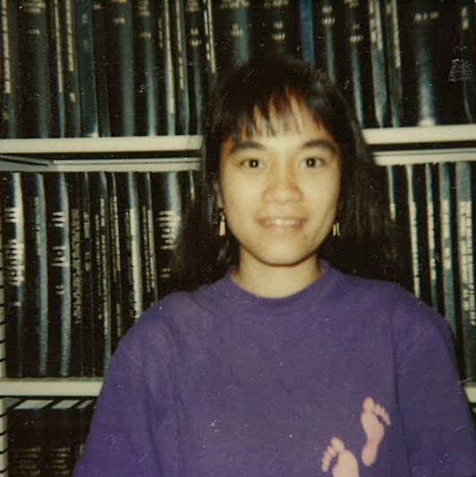
Loan Le

Slide 49
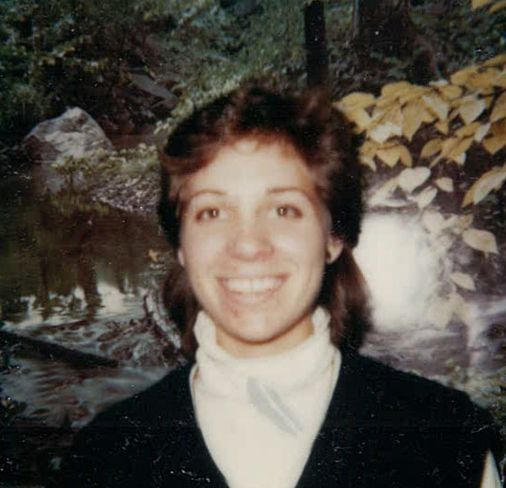
Jeni Lewis

Slide 50
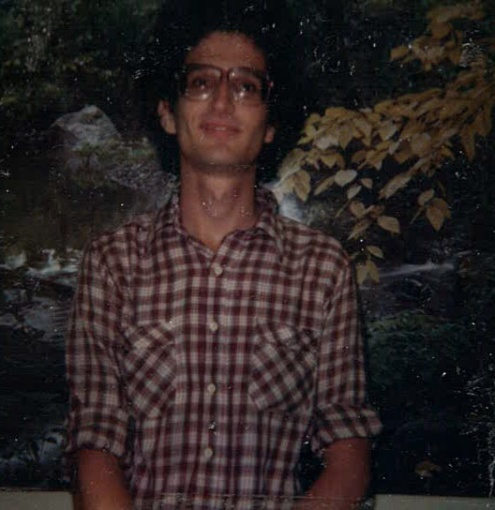

Slide 51
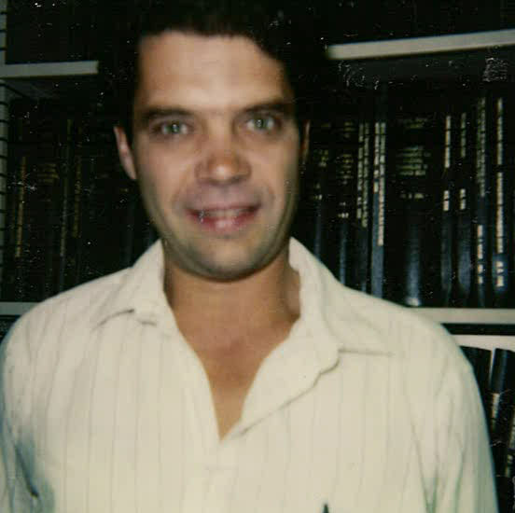
David Duval

Slide 52
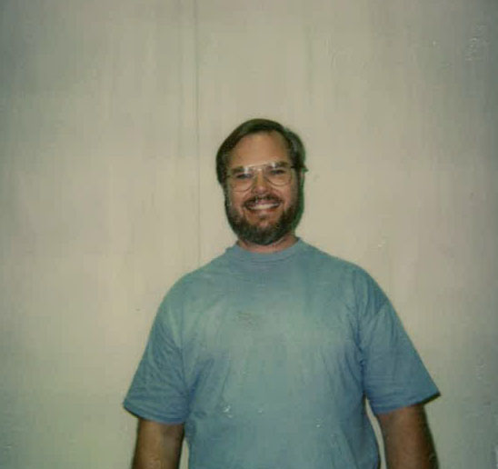
Ray Carpenter

Slide 53
Greg Mayeur

Slide 54
Shuman Mitra

Slide 55
William Miller

Slide 56
Kevin Hase

Slide 57
Benny Gallardo

Slide 58
Rajesh Krishnan

Slide 59
Judith Schneider

Slide 60
Karl Ewald

Slide 61
Kenneth Harris

Slide 62
Mark Tracy

Slide 63
Jason Smith

Slide 64
Turgut Kosar

Slide 65
Martin Chui

Slide 66
Eric Zhang

Slide 67
Ayse Batigun

Slide 68
Alana Corbett

Slide 69
Yan Wang

Slide 70
Loan Anh Le

Slide 71
Hin-Yun Lee

Slide 72
Wanbum Lee

Slide 73
Tran Ly

Slide 74
Lynne Kawakami

Slide 75
Donna Kong

Slide 76
George Kaschner

Slide 77
Jonathan Hensley Jr.

Slide 78
Richard Drawhorn

Slide 79
Scott Dickerson

Slide 80
Debra Desrochers

Slide 81
James Dekker

Slide 82
John Devlin

Slide 83
Andre Chevreau

Slide 84
Ching-Chuan Chang

Slide 85
Tsz-Keung Cheung

Slide 86
Andrew Callin

Slide 87
Gregory Cardinale

Slide 88
Housam Binous

Slide 89
Shivaun Archer

Slide 90
Marco Arocha

Slide 91
Rolf Jentoft

Slide 92
David Clague

Slide 93
Darren Arola

Slide 94
Ken Anderson

Slide 95
Anthony Kim

Slide 96
Eric Hanczyc

Slide 97
Keith Fruzzetti

Slide 98
Greg Young

Slide 99
David Slade

Slide 100
Bill Weber

Slide 101
Steve Hong

Slide 102
Sang Yoo

Slide 103
Hicham El Mrini

Slide 122
Toshi Kakizono

Slide 187
Ilhan Sezgi

Slide 188
Carinna Tong

Slide 189
Vinay Gupta

Slide 191
Vincent Craig

Slide 192
O. Bong Yang

Slide 193
Silvia Dante

Slide 194
Timothy Dubrousky

Slide 195
Keith Fruzzetti

Slide 196
Ching-I Chen

Slide 197
Chingyi Chang

Slide 198
Ceki Celardin

Slide 199
Jorge G. Siri

Slide 200
Derek Owen

Slide 201
Kirti Patel

Slide 202
Joe Krozel

Slide 203
Terese Bogucki

Slide 204
Yuan Shi

Slide 205
Ebru Aydin

Slide 206
Ming Wang

Slide 207
Kent Strong

Slide 208
Rabia Ballica

Slide 209
Ramesh Damani

Slide 210
Abbas Al-Elg

Slide 211
Richard Sheibley III

Slide 212
Krishna Meka

Slide 213
John Thorup

Slide 214
Shaoming Hu

Slide 215
Yan Wang

Slide 216
Iftikahar Gohar

Slide 217
Stergios Yiantsios

Slide 218
Tom Morrison

Slide 219
Vicente Garza

Slide 220
Wendy Austin

Slide 221
Wissam Barakat

Slide 222
Razieh Semnani

Slide 223
Gordon Alexander

Slide 224
Karen Nishimura

Slide 225
Tetsuya Morita

Slide 226
Naser Zargar

Slide 227
Alberto Ochoa

Slide 228
Li-Yang Chang

Slide 230
Motonobu Goto

Slide 231
Jayme Goodale

Slide 232
Stamatis Pagakis

Slide 233
Allen Northrup

Slide 234
David Platt

Slide 235
Sun Ho Park

Slide 236
Dan Hayes

Slide 237
Jay Kim

Slide 238
Nishant Bhattia

Slide 239
Pak-Chi Leung

Slide 240
Dan Schwartz

Slide 241
Alan Shi

Slide 242
David Bortner

Slide 243
Cynthia Castronovo

Slide 244
Brent Mittelstadt

Slide 245
Jorge Gabitto

Slide 247
Kristin Peterson

Slide 248
Otoniel De Jesus Cantu

Slide 249
Gilda Wai-Fong Lee

Slide 250
Stuart McPherson

Slide 251
Peter Allen

Slide 252
Carlos Martin

Slide 253
Luis Arrua

Slide 254
Samir N. Salvi

Slide 255
Kishore Vattikuti

Slide 256
Sassan Falsafi

Slide 257
Beverly Tai

Slide 258
Tom Colussi

Slide 259
David Scott Clague

Slide 260
Kristan Buck

Slide 261
Jedediah Paulson

Slide 263
Brian Gates

Slide 264
Hongyong Xue

Slide 265
Lanny Van Griffin

Slide 266
Fuat Doymaz

Slide 267
Bill Weber

Slide 268
Kevin Hase

Slide 269
John Devlin

Slide 270
Dr. Takei Tomida

Slide 271
Wayne Bequette

Slide 272
Benny Gallardo

Slide 273
Bill Miller

Slide 274
Richard Sheibley III

Slide 275
Loc Vinh Tran

Slide 276
Jung Ho Woo

Slide 277
George Hou

