Slide 1
Go-Live Countdown
10
41
DAYS

Slide 2


Change Network
February, 2019

Slide 3

Agenda
Welcome
Review February “Meeting in a Box” Topics
- Talent Acquisition Management
- ePerformance
- Benefits
- DUO/Direct Deposit
- Cutover/Freeze Activities
Question & Answer Session
UCPath Updates
Next Steps

Slide 4

Talent Acquisition Management (TAM)
Notes:
Purpose:
Craft a framework to transition knowledge from UCPath Team to future Functional Owners and Users
Group similar UCPath processes into manageable topics
Create an end to end flow of topics
Define participant roles
Establish a framework for scheduling sessions

Slide 5
Topics
TAM overview
What’s new
Training
Preview TAM

Slide 6
TAM Overview
TAM is the UCPath module for staff recruitments and replaces:
  PeopleAdmin at Davis Campus
  PeopleSoft eRecruit (v8.8) at UC Davis Health
April 1 - TAM will be implemented across UC Davis
  Use TAM to:
  Create and manage job openings
  Enter and manage applicant information
  Search for job openings and applicants
  Screen and route applicants
  Disposition applicants
  Manage interviews
  Manage offers
  Prepare hire
Notes:
Academic positions will continue to be hired with UC Recruit
We can expect some bumps at go-live
Recruiting has a wide touch into the organization so bumps will be highly visible
Undergrad students will continue their current process with Aggies Job Link (to be replaced by Handshake)
Possible future alignment with TAM
Academic and student hires will be entered in UCPath via the Template Based Hire by the Service Channels

Slide 7
TAM Overview
Recruited through TAM:
  Staff positions
  Staff physicians
  Residents and fellows
  Student staff positions (Health)
NOT recruited through TAM:
Academics
Academic students
Summer Session instructors
Student staff employees (Campus)
Camp counselors
University Extension students
Senior Management Group
Externs and observers
Contingent workers (CWR)

Slide 8
TAM Overview
PeopleAdmin at Davis Campus will:
  Continue to be used for the Position Description library and classification
OnBase at UC Davis Health will:
  Continue to be used as the Position Description repository
Position Descriptions After UCPath Go Live
We anticipate that both the Davis Campus and UC Davis Health will utilize a common Position Description Library at some point in the future.
Notes:
Academic positions will continue to be hired with UC Recruit
Undergrad students will continue their current process with Aggies Job Link (to be replaced by Handshake)
Possible future alignment with TAM
Academic and student hires will be entered in UCPath via the Template Based Hire by the Service Channels

Slide 9
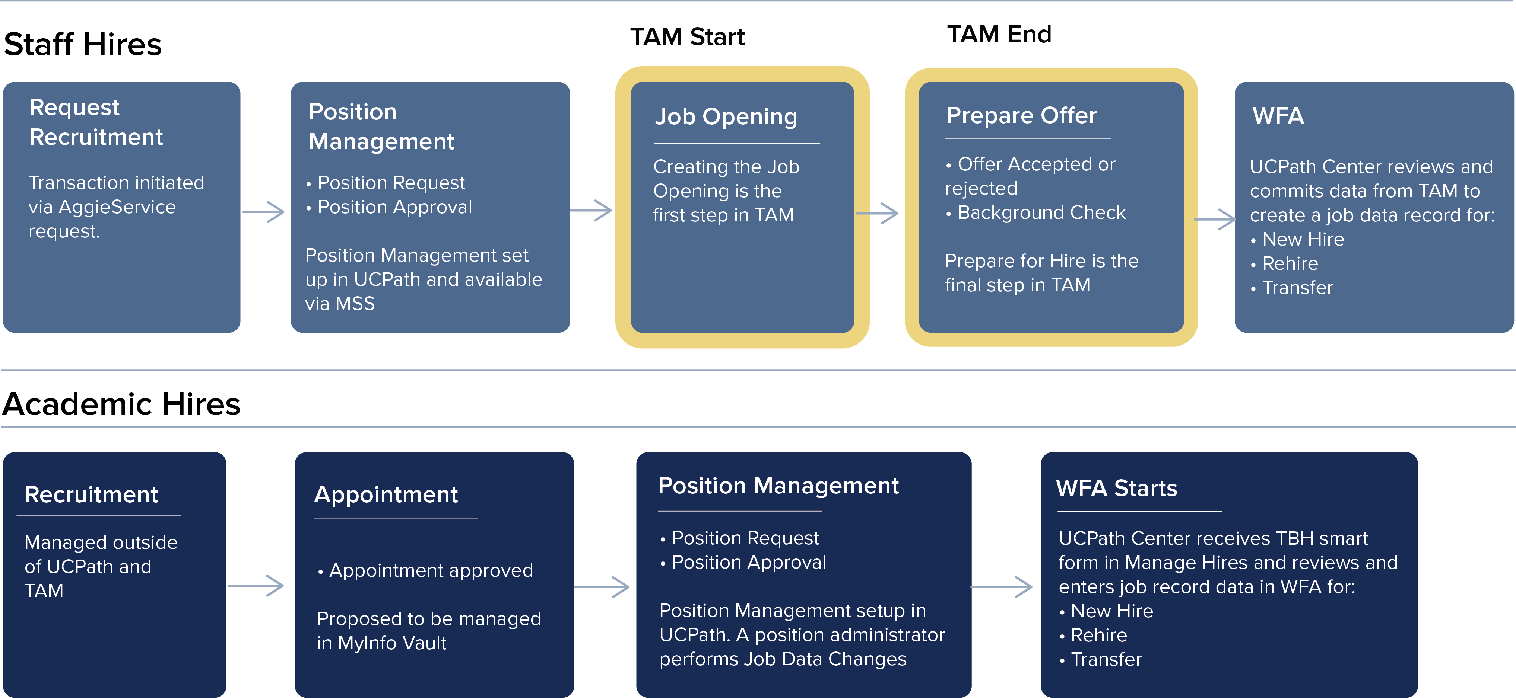
TAM Overview
Notes:
Position management or the PD requisition process are two different things Today position management and recruitment
Manage Offer should be Prepare Offer
Position request – predecessor process will be done in AggieService
At Health someone submits a job requisition and
Service Channel will open up the Job Opening
A lot of people at Health will no longer be able to open up a ticket
TAM hires you don’t have to key in the data because it flows from application
. Position Management: Each budgeted provision will have a unique permanent position number, that it will retain over time, whether vacant or filled, when reclassified, and through various other changes. A new action number is assigned for each action taken (e.g., stipend, reclassification, etc.), but the position number will not change.
Position Description Library: Once approved, a position description is retained in the Library, with its unique position number. It can be accessed there for use to initiate various personnel actions.
Position Management, in which actions such as creating or editing position descriptions, vacating or inactivating positions, or managing compensation actions are accomplished. 2. Recruitment, in which the department can initiate and process all types of recruitments, by using a position description approved to the Library in the Position Management mode. For details on the Recruitment process refer to the Requisition/Recruitment and User Guide

Slide 10
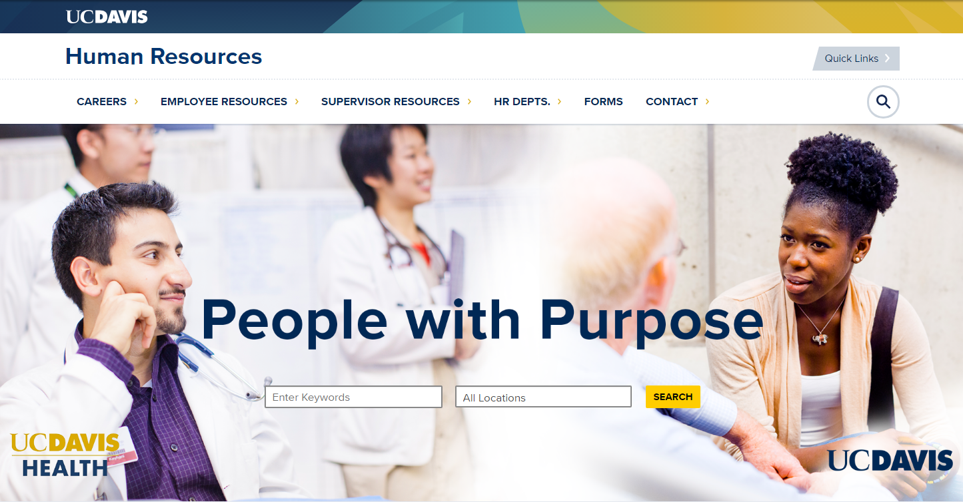

Slide 11
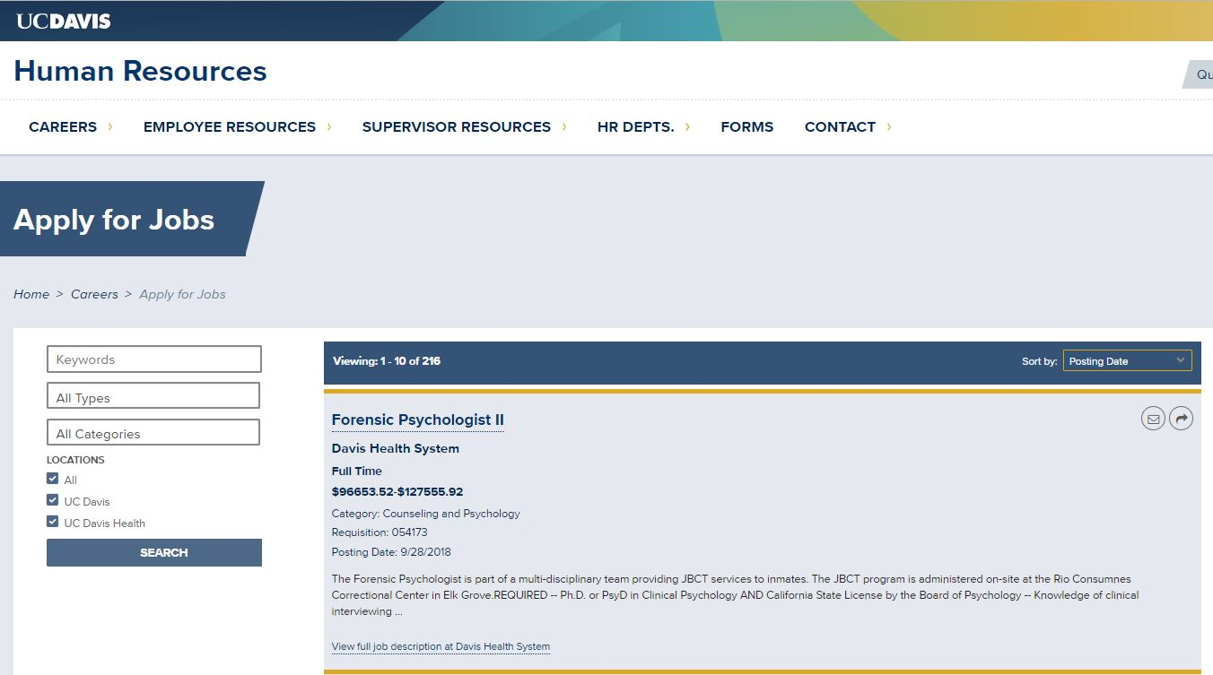
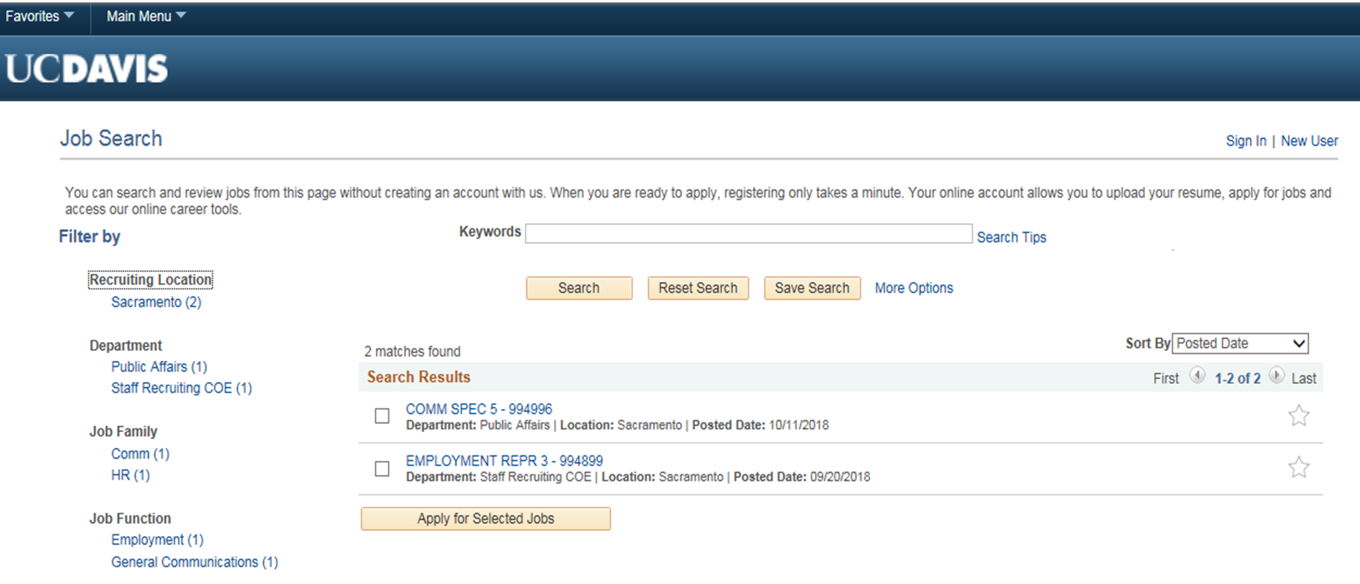
TAM Overview
Candidates can view all UC Davis jobs on the HR website
Applications are submitted through Davis Campus OR UC Davis Health TAM Candidate Gateway.
Depends on location of position
Notes:
The career page is the first landing spot where we talk about ourselves
The Davis Campus and UC Davis Health are separate business units in UCPath.

Slide 12
Benefits of TAM
Applicant
  Resume parsing simplifies application process
  Updates on application status provided through the candidate gateway and by email
Hiring Manager
  At-a-glance manager dashboard
  Receive twice-daily email update on recruitment status
Recruiter
  Ability to source “alternate” candidates for future recruitments
  At-a-glance recruiter dashboard
Notes:
Improved applicant experience – parsing is technology that helps populate an application based on a text in a resume, your LinkedIn account, etc.
People will no longer be lost in the process as notifications come via the applicant dashboard and by email:
- Includes notification when you are no longer under consideration.
Hiring Managers will get emails at noon and midnight announcing how many people have been moved forward in the process
Recruiter:
Improved search capability including Boolean-like and “alternate” disposition candidate sourcing
At-a-glance recruiter dashboard
Using the alternate candidate – you reject the person as an alternate candidate so you can begin reaching out to people “mine” them for future recruitments
This becomes more like a sourcing thing
Improved search capabilities

Slide 13
What’s Changing
 | Current Process | Future Process
Position and Requisition | Workflows for Position Request and Job Requisition are together | Position Request precedes the TAM Job Opening Both will be requested with a single AggieService request
Applicant Tracking | View one applicant at a time | At-a-glance dashboards for recruiters and managers in TAM
Scheduling Interviews | Outside of system | You may continue using your current scheduling practice (Summary interview results are entered in TAM)
Conditional Offer Letters | Outside of system | Verbal offers continue The Conditional Offer Letter will be generated from TAM Candidate views letter in candidate gateway and accepts/rejects offer
Hire Data Entry | Hire keyed into PPS/PeopleSoft | Prepare Hire submitted from TAM to UCPath Center
Approval Workflow | Custom approval workflow | Approval workflow routes to reports-to manager
Notes:
Conditional offer letter sent from TAM – all letters are conditional (background, live scan, physical)
May be able delegate approvals to another who has the approver role
Candidates will accept/reject offer through the Candidate Gateway
Service channel can follow up with welcome letter
You can renegotiate and send new offers
Typically
Department will continue to do processes they do today so offer can officially send offer (you will probably have a conversation first)
A lot of what you do outside the system will continue with UCPath, but there will be some steps in the system.
We’re not taking the human out of this.
Service channel can follow up with welcome letter

Slide 14
TAM Training
  Courses will be a mix of required and optional based on job role
Oct-Jan
Train the Trainer Review & Orientation Sessions
Feb - Mar
Training for Service Channel & Central Office Users
March
April
UCPath Go Live
Learning Labs
UCPath Cutover
Training for Dept. Users
eLearning
TAM Overview
Manage Job Openings and Postings
Applicant Search and Add
Manage Applicants, Interviews and Offers
Prepare for Hire in TAM
TAM Employee Tasks
  Visit the UCPath Training Resources web page to access courses & guides.
Notes:
eLearning exists
Classroom training will be offered to Recruiters and Service Channel personnel.
Webinars will be held just before go live (just in time).
Courses will be a mix of required and optional based on job role
Department user training late February through March

Slide 15
Preview TAM

Slide 16
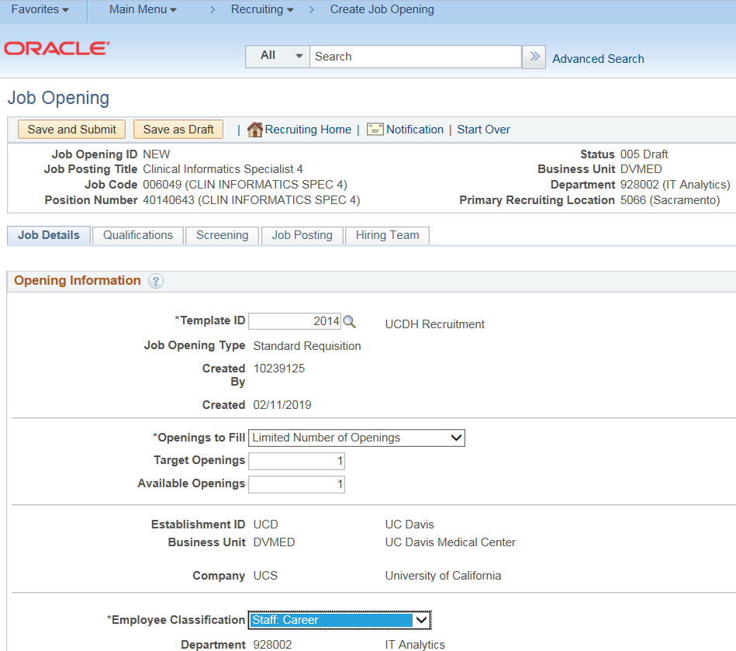
Position Request
Precedes process for Job Opening in TAM
Produces required Position Number
Job Opening
Entering the Position Number populates the Job Opening
Uses data from the Position record
Employee Classification is required
(e.g. Career, Per Diem)
Notes:
this produces a position number, which is mandatory

Slide 17
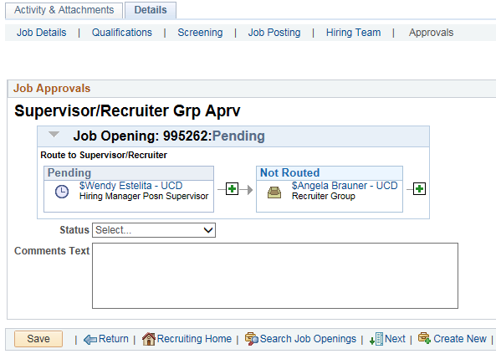
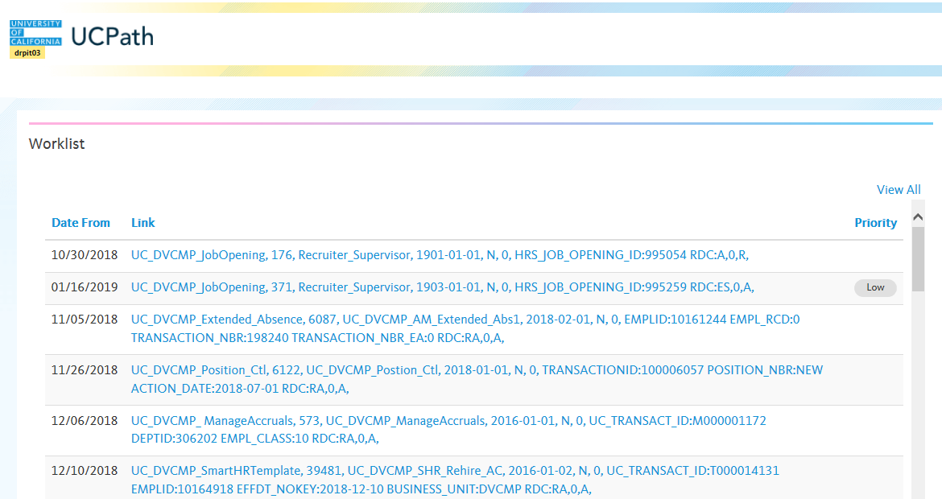
Approvals
Job Opening and Offer route to Reports-to Manager for approval
Status = Pending Approval

Slide 18
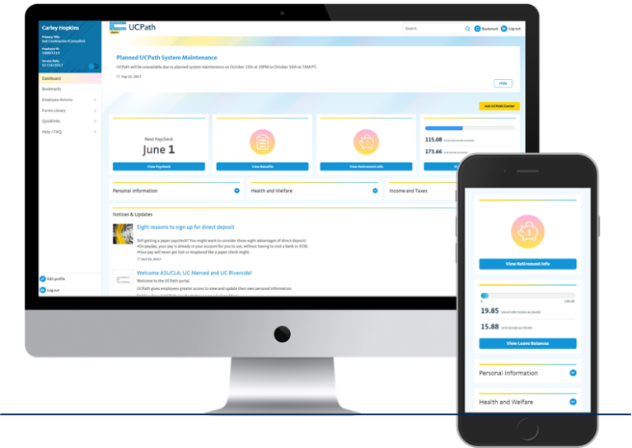
UCPath Portal
Role-based access to TAM for managers, employees and HR professionals
Notes:
TAM will be accessed via MSS, ESS and PeopleSoft Recruiting link based on your role

Slide 19
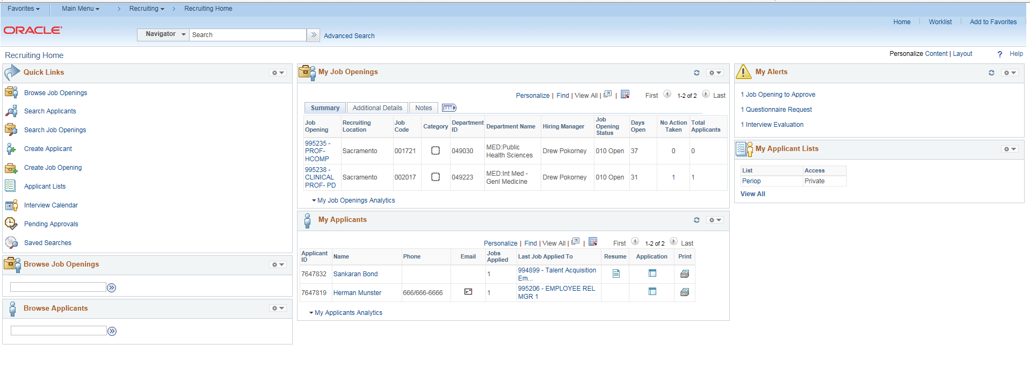
Recruiting Home
Notes:
This is a picture of the TAM home page in UCPath

Slide 20
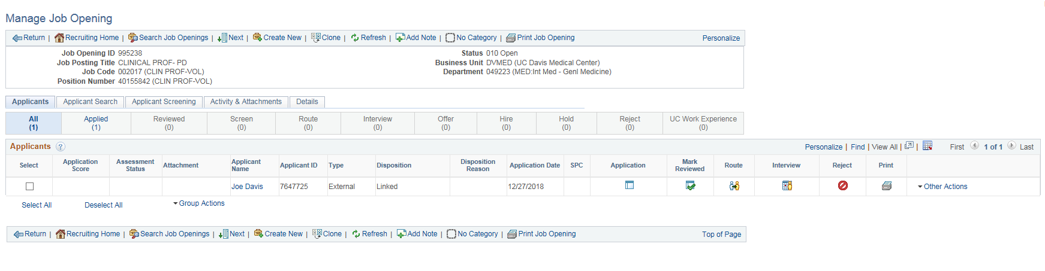
Manage Job Opening

Slide 21
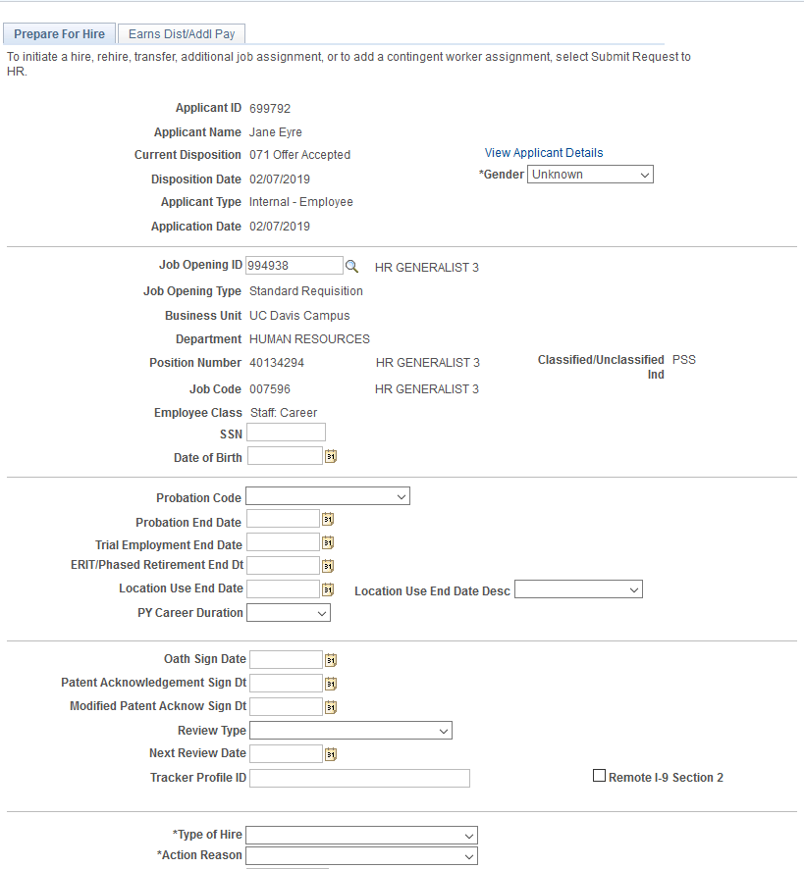
Prepare Hire
1. Service Channel submits the
Prepare Hire action, after the offer is accepted:
  Hire
  Re-Hire
  Transfer
2. UCPC receives the transaction in their Manage Hire queue and completes hire action in Workforce Administration
3. Employee ID is generated

Slide 22
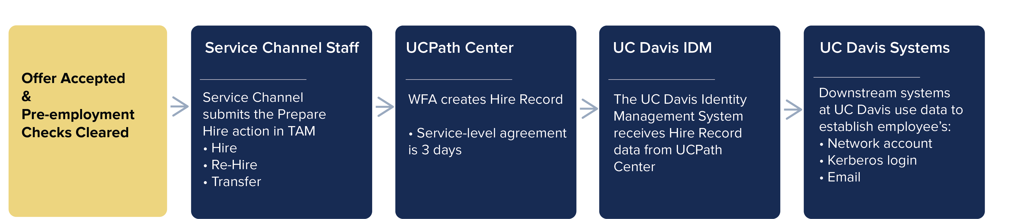
New Hire Data Flow
Guidance on Changing Start Date
Changing the start date after submitting the Prepare Hire to the UCPath Center should be considered an exception​​

Slide 23
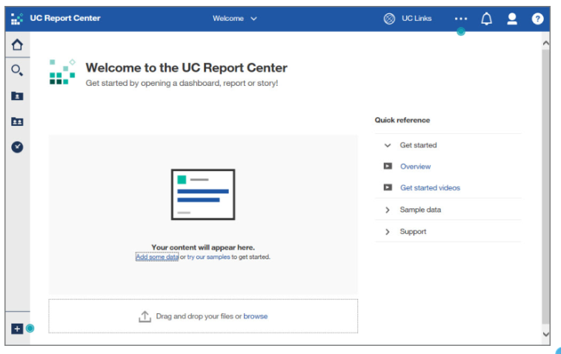
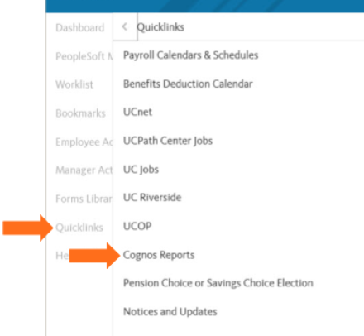
Reports
Recruiting and other HR reports will be available on the UC Report Center via the UCPath Portal

Slide 24
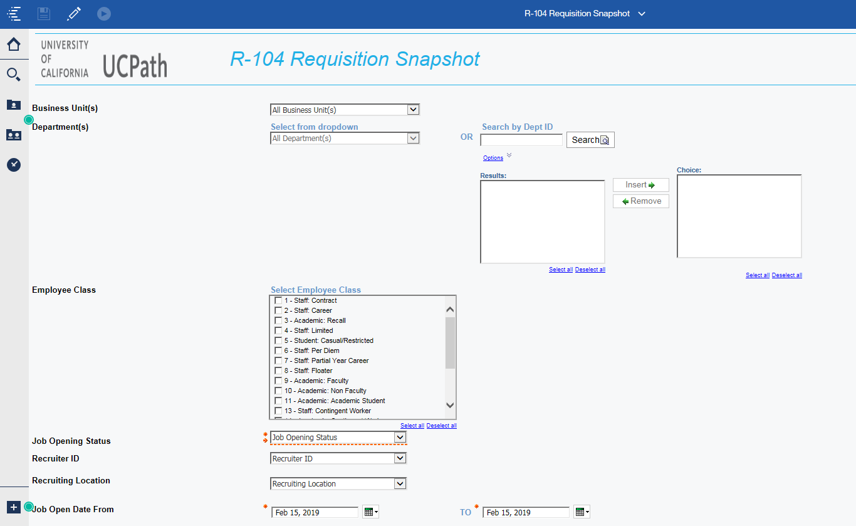

Slide 25
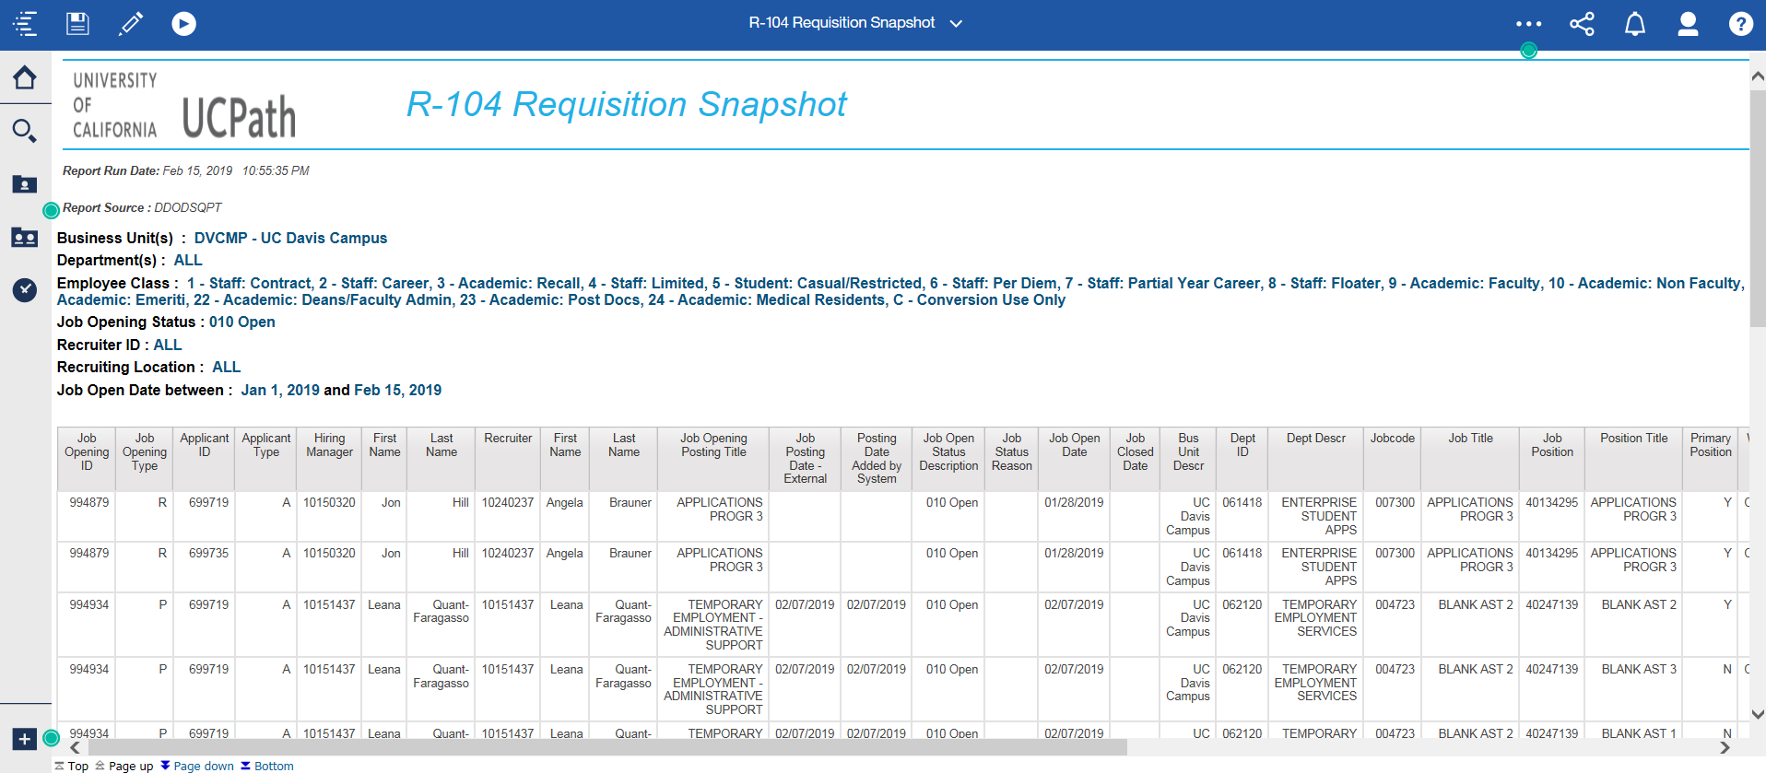

Slide 26

Questions re: TAM?
Notes:
What questions do you have about Reports/reporting?
Let’s list the questions we have which I will submit to the UCPath project team for their responses

Slide 27

ePerformance
Notes:
This update focuses on UCPath Finance Functions, with emphasis on the processes for entering funding sources and for doing salary cost transfers.

Slide 28
UCPath ePerformance Overview
ePerformance is the performance management module of UCPath for staff employees
The following locations are implementing ePerformance
  UCOP, Riverside, Irvine, Irvine Health, Davis, Davis Health, ANR, Berkeley, San Francisco, San Francisco Health, Santa Cruz
ePerformance is managed locally — not at the UCPath Center
UC Davis and UC Davis Health will use the same templates and rating scales in ePerformance
Human Resources will continue to communicate the schedule for all annual evaluations
Notes:
Carina

Slide 29
UCPath ePerformance Access and Key Features
Access ePerformance
  Web-based links will be posted on Service Channel websites
  Bookmark the URL for easy access
Dashboards
  Summary “dashboard” to view multiple evaluations
  Mass approvals to approve multiple evaluations
  Real time supervisor reports to track review completion status
Nomination feature (pilot for non-rep)
Notes:
Carina
The nomination process is a new feature to UC Davis (initially piloted for non-represented employees) that solicits feedback on an employees performance from individuals identified by the employee and/or the supervisor.
Pilot approach for 2020, exploring new feature…

Slide 30
What’s Changing
Campus and Health will be using the same performance management system for staff who currently use EPAR or ePerformance
  Campus employees will transition from the EPAR system to UCPath ePerformance
  Health employees will transition from ePerformance UCPath ePerformance
UC Davis will use ePerformance for:
  Probationary Reviews
  Annual Performance Evaluations
Performance evaluation ratings will be consistent at both Campus and Health, and for Represented and Non-Represented staff (with the exception of Nurses and Police who have separate established rating scales)
Notes:
Steve

Slide 31
New aligned UC Davis UCPath ePerformance employee evaluation ratings:
(To be rolled out as employee groups transition to UCPath ePerformance)
What’s Changing, continued…
Represented and Non-Represented Staff Ratings
Exceptional
Exceeded Expectations
Fully Achieved Expectations
Some Expectations Met
Expectations not Met
Notes:
Steve
UC Davis Human Resources will be standardizing performance appraisal ratings for all represented and non-represented employees (with the exception of Nurses and Police who have separate established rating scales). This will take effect as employee groups transition to UCPath ePerformance

Slide 32

February 2019:
NX - Legacy system
March 2019:
99 and K-3 - Legacy system
April 2019:
UCPath scheduled to “go live” at UC Davis
CX, F3 and DX - Legacy system
May 2019:
HX, RX, and TX - UCPath ePerformance
December 2019:
EX and SX - UCPath ePerformance
February 2020:
NX will - UCPath ePerformance
March 2020:
99 & K-3 - UCPath ePerformance
April 2020:
CX, F3, & DX - UCPath ePerformance
When is it Changing?
Employee groups will transition to UCPath ePerformance as their calls for evaluation are announced:
Probationary documents for all PSS career employees hired after April 1, 2019 will be completed in UCPath ePerformance
Notes:
Steve

Slide 33

Training…
Training will be provided on the new ePerformance system with targeted messages going out to employees and supervisors as their calls for evaluation are announced
UCPath Training Resources
  eLearning available via UCPath website
  Help Desk Support
    Email epasupport@ucdavis.edu (Campus)
    Submit a ServiceNow ticket (Health)
UCPath ePerformance
Notes:
Steve

Slide 34
Employees not affected
The following populations will not have annual evaluations in UCPath ePerformance:
    Academics
    Contract Physicians
    Residents and Fellows
    Senior Management Group (SMG)
    Student Employees
    Temporary Employment Services Staff (TES)
    Limited Term Employees (if less than 50%)
    Contract Employees (if less than 50%)
Notes:
Steve
This is the same as previous practice

Slide 35
ePerformance Roles
Employee:
    Completes self-evaluation
    Proposes individual goals
    Ability to add comments to final evaluation
    Acknowledges final evaluation
Supervisor:
    Finalizes feedback participant list (optional)
    Writes and finalizes evaluations
    Meets with the employee to discuss evaluation
    Releases evaluation for employee to review and acknowledge
    Submits evaluation for “reports to” supervisor to approve
Approver:
    Approves/Denies evaluation (denied evaluations are returned to the submitter for edits)
      One step approval for Probationary and Annual evaluations based on “reports to” structure
Notes:
Steve

Slide 36
    Optional Nomination of Participants (pilot)
    UC Davis Campus - Feature limited to non-represented employees
    UC Davis Health - Feature limited to non-represented employees and UCDH Primary Care Network nursing staff
    Employee nominates others to contribute feedback
    Supervisor reviews and can modify nominee list
      Employee does not see final nominee list
    Nominees accept/decline invitation to participate
    Nominees complete feedback; results are available to supervisor
      Employee does not see feedback
    Supervisor reviews and incorporates feedback as appropriate
Notes:
Steve
Discuss pilot for non-rep employees

Slide 37
Probationary Evaluation
    Three months after employee start date:
      Supervisor completes probationary midpoint feedback and shares with employee
      Supervisor and/or employee develop goals
    Six months after employee hire date:
      At least 2 weeks prior to employee 6 month anniversary, supervisor completes final probation evaluation and shares with employee
    Supervisor routes final probationary evaluation for approval
    NOTE: Probation evaluations for employees hired BEFORE UCPath go-live, 2019 will be completed in legacy system
Notes:
Steve

Slide 38
ePerformance Screen Shots
Notes:
Bill

Slide 39
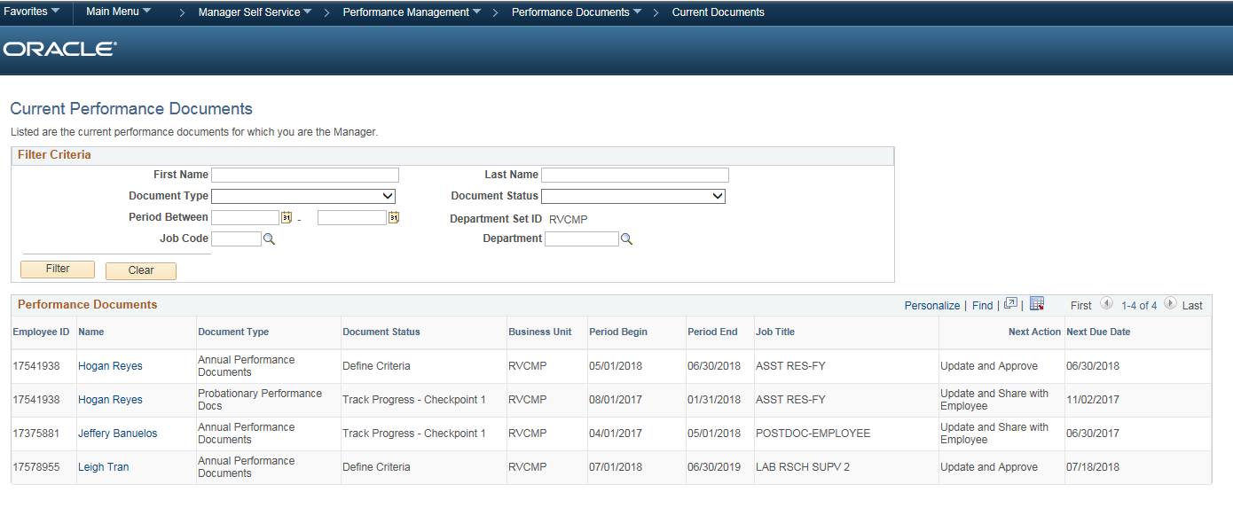
Notes:
Bill

Slide 40
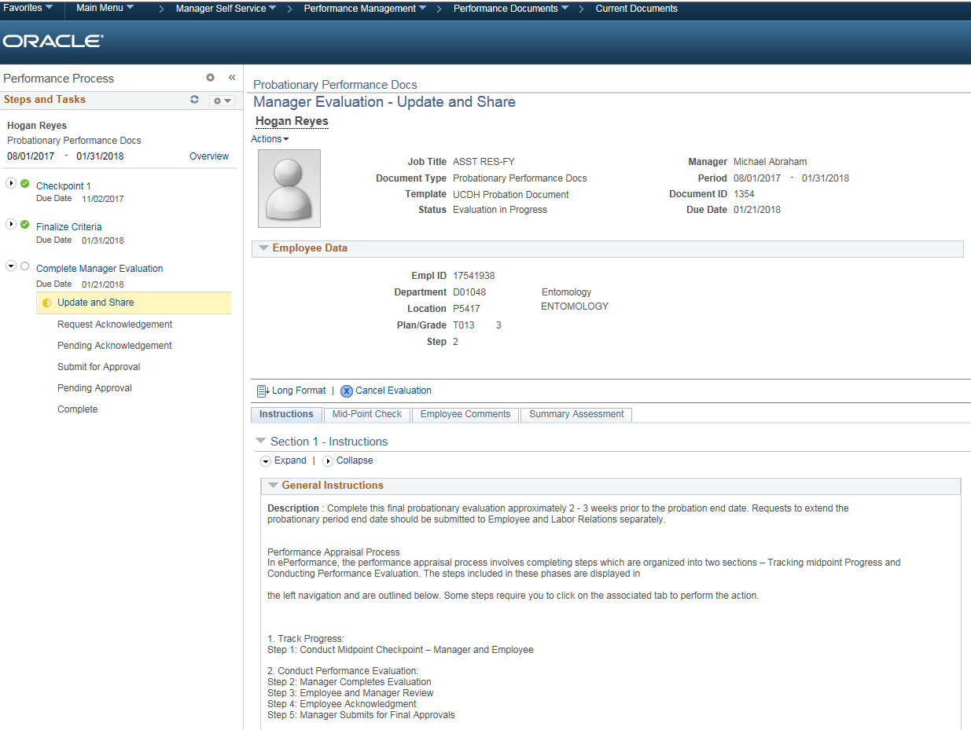
Notes:
Bill

Slide 41
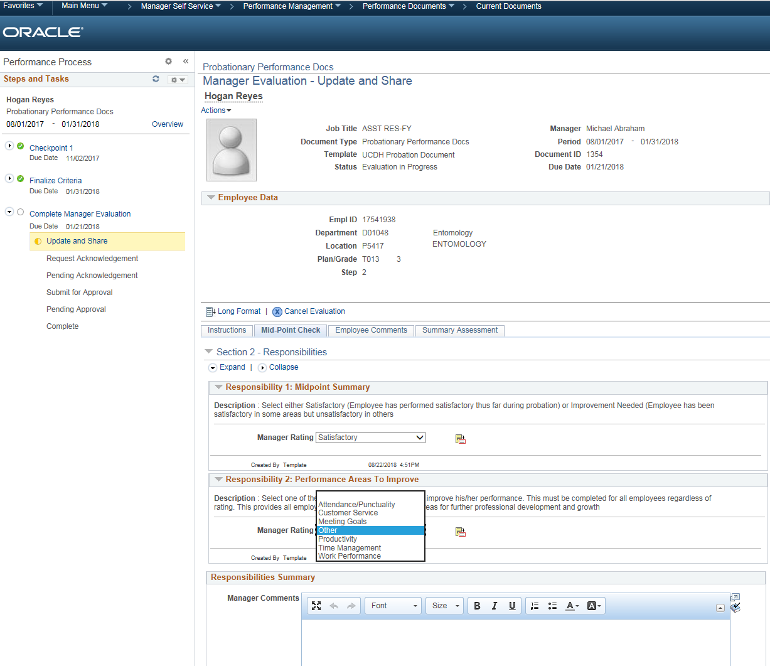
Notes:
Bill

Slide 42
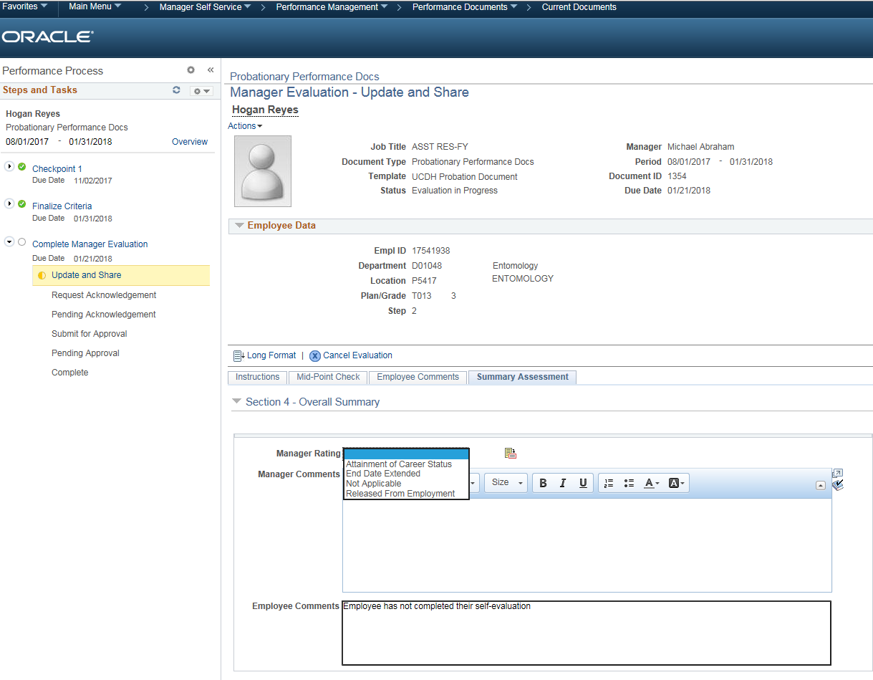
Notes:
Bill

Slide 43
Questions re: ePerformance?
Notes:
What questions do you have about Finance functions in UCPath?
Let’s list the questions we have which I will submit to the UCPath project team for their responses

Slide 44
Additional Topic Updates
Notes:
This update focuses on UCPath Finance Functions, with emphasis on the processes for entering funding sources and for doing salary cost transfers.

Slide 45
Cutover Activities/Freeze Dates
Important cutover activity and freeze dates posted on the website:
https://ucpath.ucdavis.edu/cutover-dates
For question, please contact your local service channel (HRSSO, AUSS-C, DiSSC, Health)

Slide 46
DUO Update
DUO IS required for access to UCPath Portal

Slide 47
Direct Deposit Update
If you already have Direct Deposit – you don’t have to do anything!

Slide 48
Online Benefits Self-Service
UCPath – Employee Self Service
At Your Service Online (AYSO)
Submitting enrollment elections
  Employment changes
  Family Status changes
    Marriage, birth/adoption
    Divorce
Making open enrollment changes
Viewing Enrollment Summary
Obtaining Form 1095-C
Sunsetting
  Separate from UCPath transition
  Systemwide initiative
Last day to make benefit elections online – Thursday, 2/28/19, 5PM
  After, contact Benefits to submit appropriate form
UC Retirement At Your Service (UCRAYS)
New portal available later in 2019
Features will include –
  Beneficiary Designation
    Life, AD&D, retirement
  Retirement Estimates
  UCRP/CAP balances

Slide 49
Base Camp Service Model
UCPC / UCOP ITS / BKPSSC
Base Camp
No
Can SvC Answer Question?
Service Channel 1st point of contact for employees/dept.
All cases opened by Command Center
Yes
Service Channels
Employees/Departments with Questions

Slide 50
Training Update

Slide 51
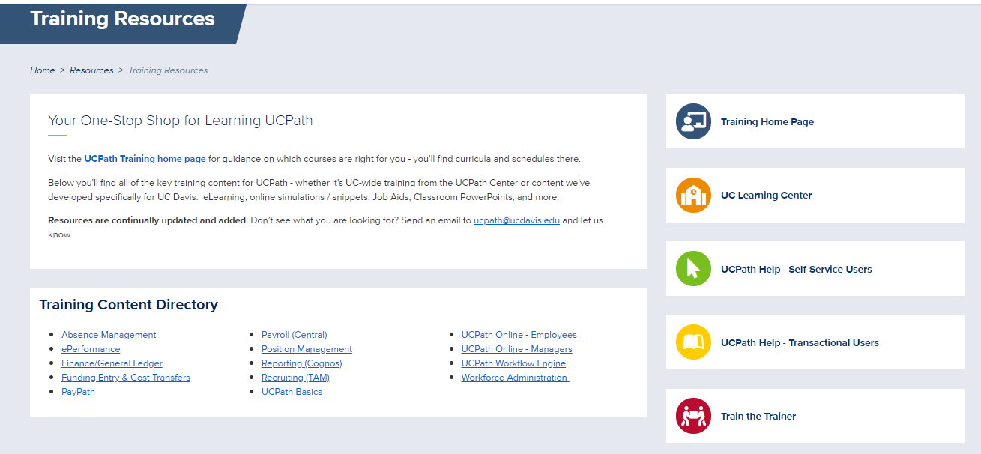
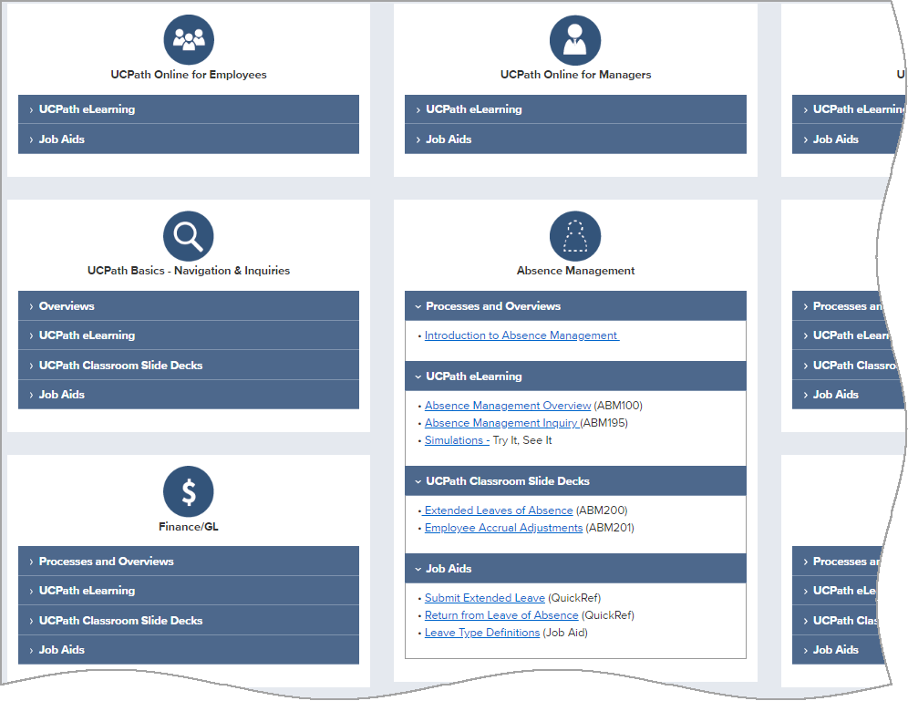
Training Resources & eLearning
Visit the Training Resources page for access to all UCPath training materials
One-Stop Shop for:
UCPath Online Help
  See It & Try It Simulations
UC Learning Center
All Types of UCPath Learning Materials
  eLearning (on UC Learning Center)
  Classroom Slide Decks
  Job Aids & Quick Reference Guides
Materials will be added or updated on a
regular basis.

Slide 52

Training Courses
Training underway for transactional users in Service Channels and Central Offices
eLearning available to all – via Training Resources page or from UC Learning Center
Department User Training
  eLearning will be supplemented with instructor-led webinars for demonstrations & to answer questions
  After Go-Live, UC Davis “Base Camp” will be available to help answer questions and provide instruction
  UC Davis-specific eLearning coming soon for Funding Entry & Salary Cost Transfers
As UCPath roles are assigned, required courses will be assigned via the Learning Center
  If you take eLearning classes before assignment, it will still record your completion

Slide 53
Change/Communication Update”

Slide 54
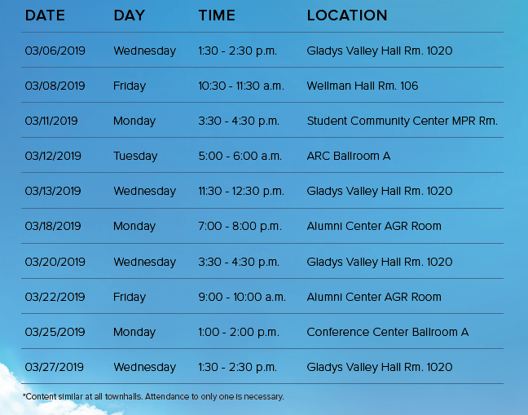
Town Hall Meetings
Please encourage employees to attend 1 of these sessions

Slide 55
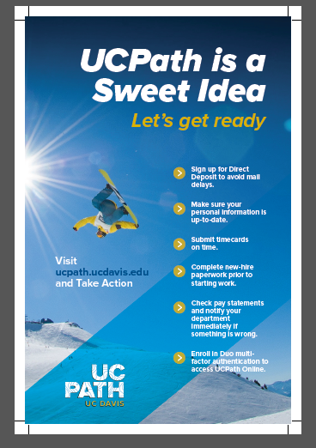
Readiness Checklist Handout/Poster

Slide 56
Academic Units Update
Academic Liaison Program underway:
9 of 9 Liaisons identified, accepted and trained to deliver UCPath presentations to academic units as of January 31, 2019.
98 academic departments identified for presentations
To facilitate department follow up after the presentations by the Liaisons, the slide deck has been added in pdf format to our UCPath website under Academic Resources at https://ucpath.ucdavis.edu/academic-resources and in the blog on the Academic Liaison program at https://ucpath.ucdavis.edu/blog/academic-liaisons-prepare-academics-and-departments-ucpath.
Graduate Student Advisors Committee presentation given on February 11, 2019.
Office of Research presentation given on February 12, 2019.
Graduate Student Association presentation scheduled for March 6, 2019.
UC Davis Service Channels are paying particularly attention to testing UCPath processes affecting student employees.

Slide 57

Upcoming Events
Town Hall Meetings
All manager/supervisor emails (Jan-March)
All employee emails (Jan – March)
Change Network Meetings (monthly)
UCPath Training
Training for Service Channels –(classroom)
Manager training – Feb - March (on line)
Employee training – March (Portal access instructions)
Please sign up for the UCPath Newsletter and Check the Website

Slide 58
UC Davis Change Network (N= 458)
  220 Members UCDavis campus
  238 Members UCDavis Health
  Monthly Topics
Month | Topic
August | UCPath Overview
September | UCPath Portal/ Employee & Manager Self Service
October | Pay Processes (checks, direct deposit, etc.)
November | UCPath Center
December | Aggie Service (Health Only)
January | Finance and Reports
February | TAM/ePerformance
March | Go Live Countdown
April | Hypercare
  Academic Liaison Faculty Meetings – January/February

Slide 59

Questions?
General UCPath Questions: ucpath@ucdavis.edu
UCPath Training Lead: Ann Foley, annfoley@ucdavis.edu
UCPath Change Management Lead: Randa Wilbur, rawilbur@ucdavis.edu
Communications Lead: BreAnda Northcutt, bnorthcutt@ucdavis.edu
Notes:
I hope this information was helpful to you.
What additional questions do you have?
Note to Change Network: Please remember to record any “problematic” questions/issues and submit to the Randa Wilbur, Change Management Lead (rawilbur@ucdavis.com).

